Slide 1
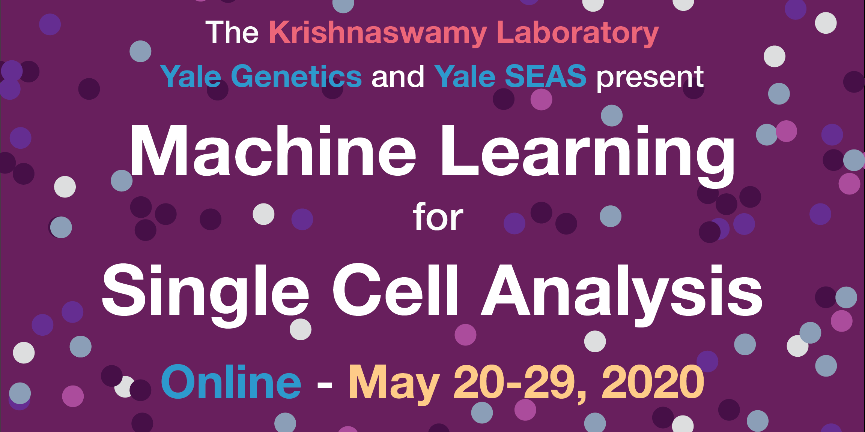

Slide 2
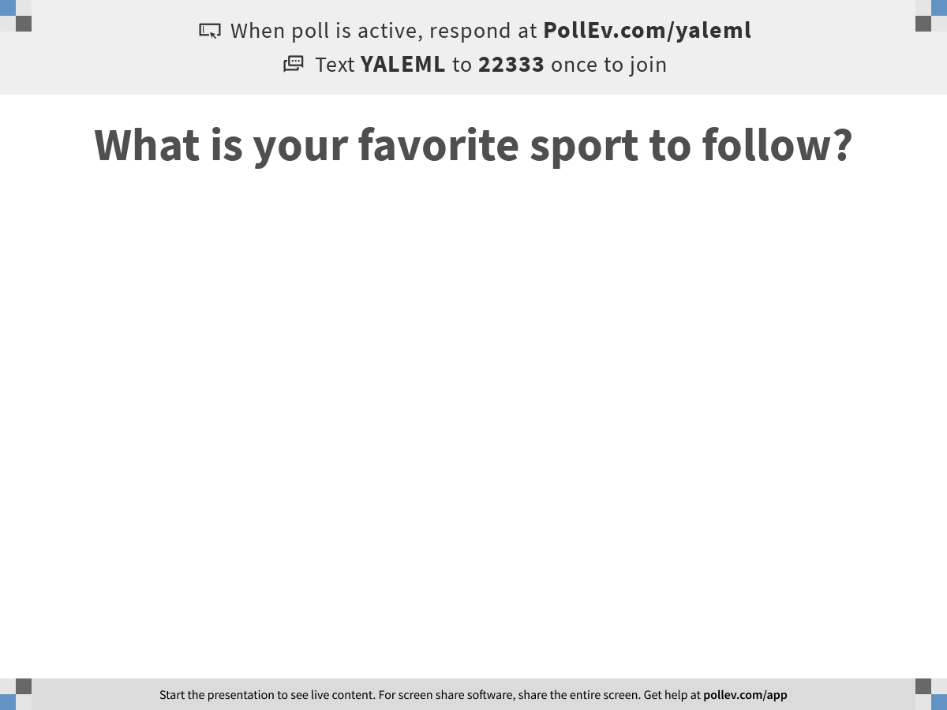
Notes:
What is your favorite sport to follow?
https://www.polleverywhere.com/free_text_polls/7LGXUTWaEUqN1IxXEZ3AP

Slide 3
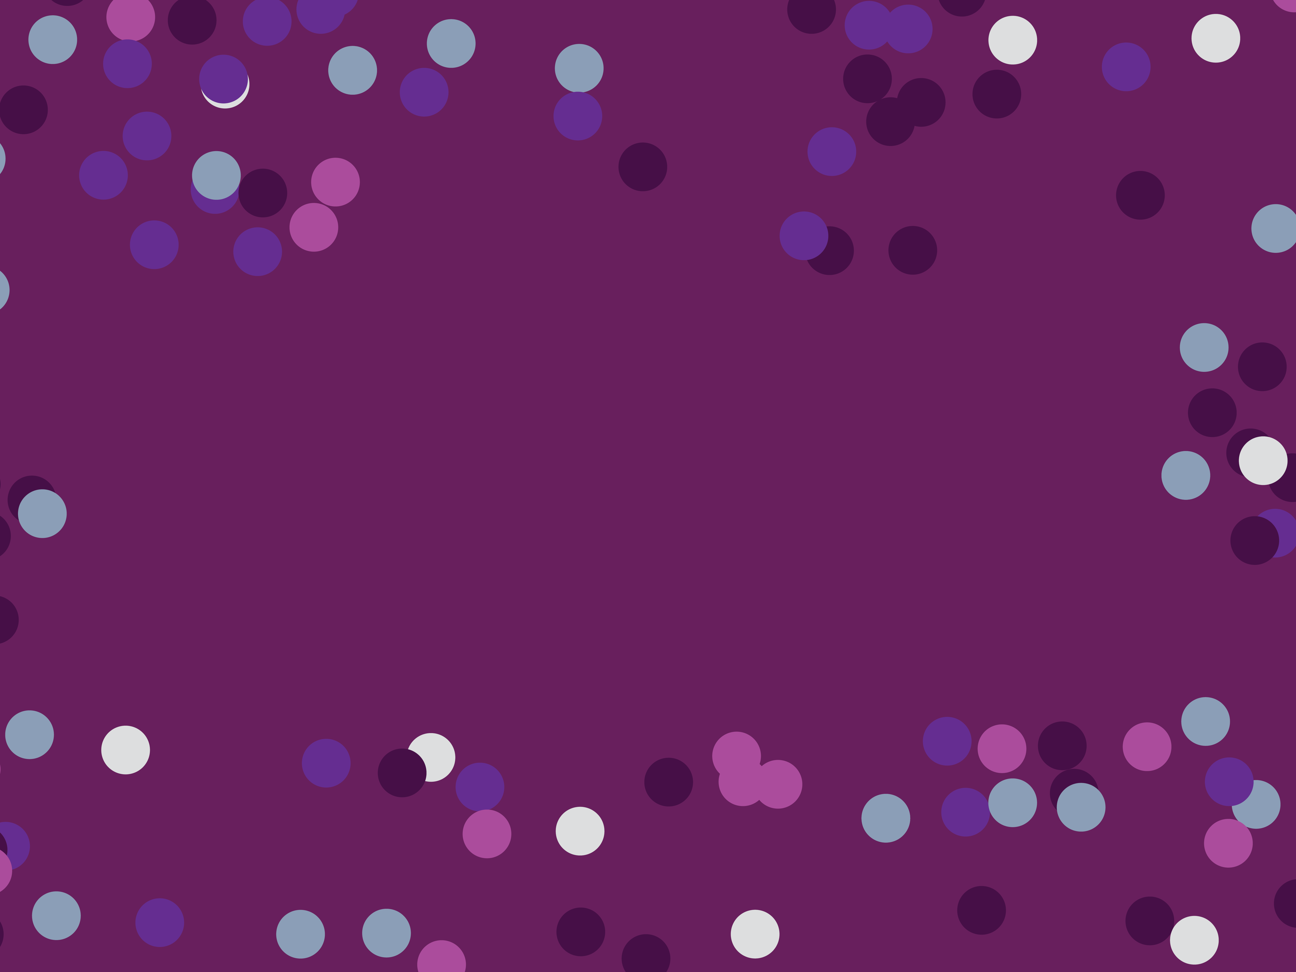
Day 3: Denoising, Batch Correction, and Clustering
Notes:
TA introduction
Talk about not teaching code (not a programming workshop)

Slide 4
Using the manifold model to denoise data
Notes:
TA introduction
Talk about not teaching code (not a programming workshop)

Slide 5
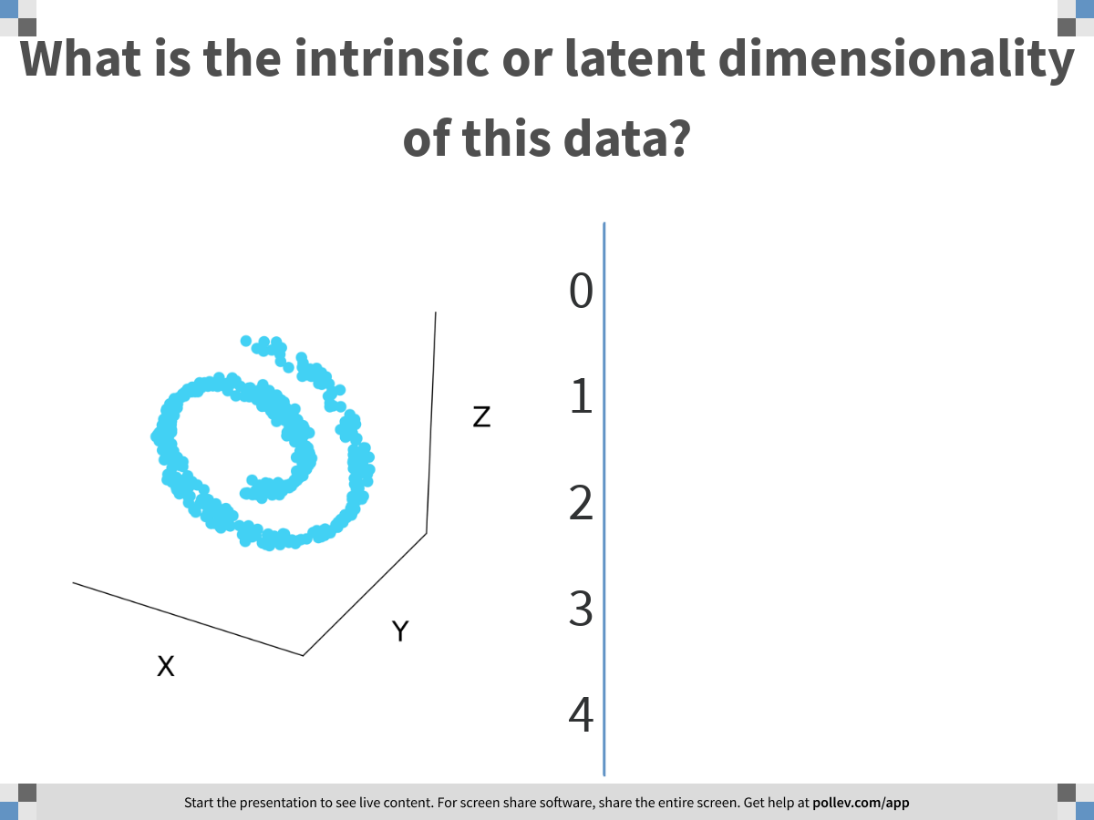
Notes:
What is the intrinsic or latent dimensionality of this data?
https://www.polleverywhere.com/multiple_choice_polls/VuedMRPvKyIBbCuDhPHwO

Slide 6
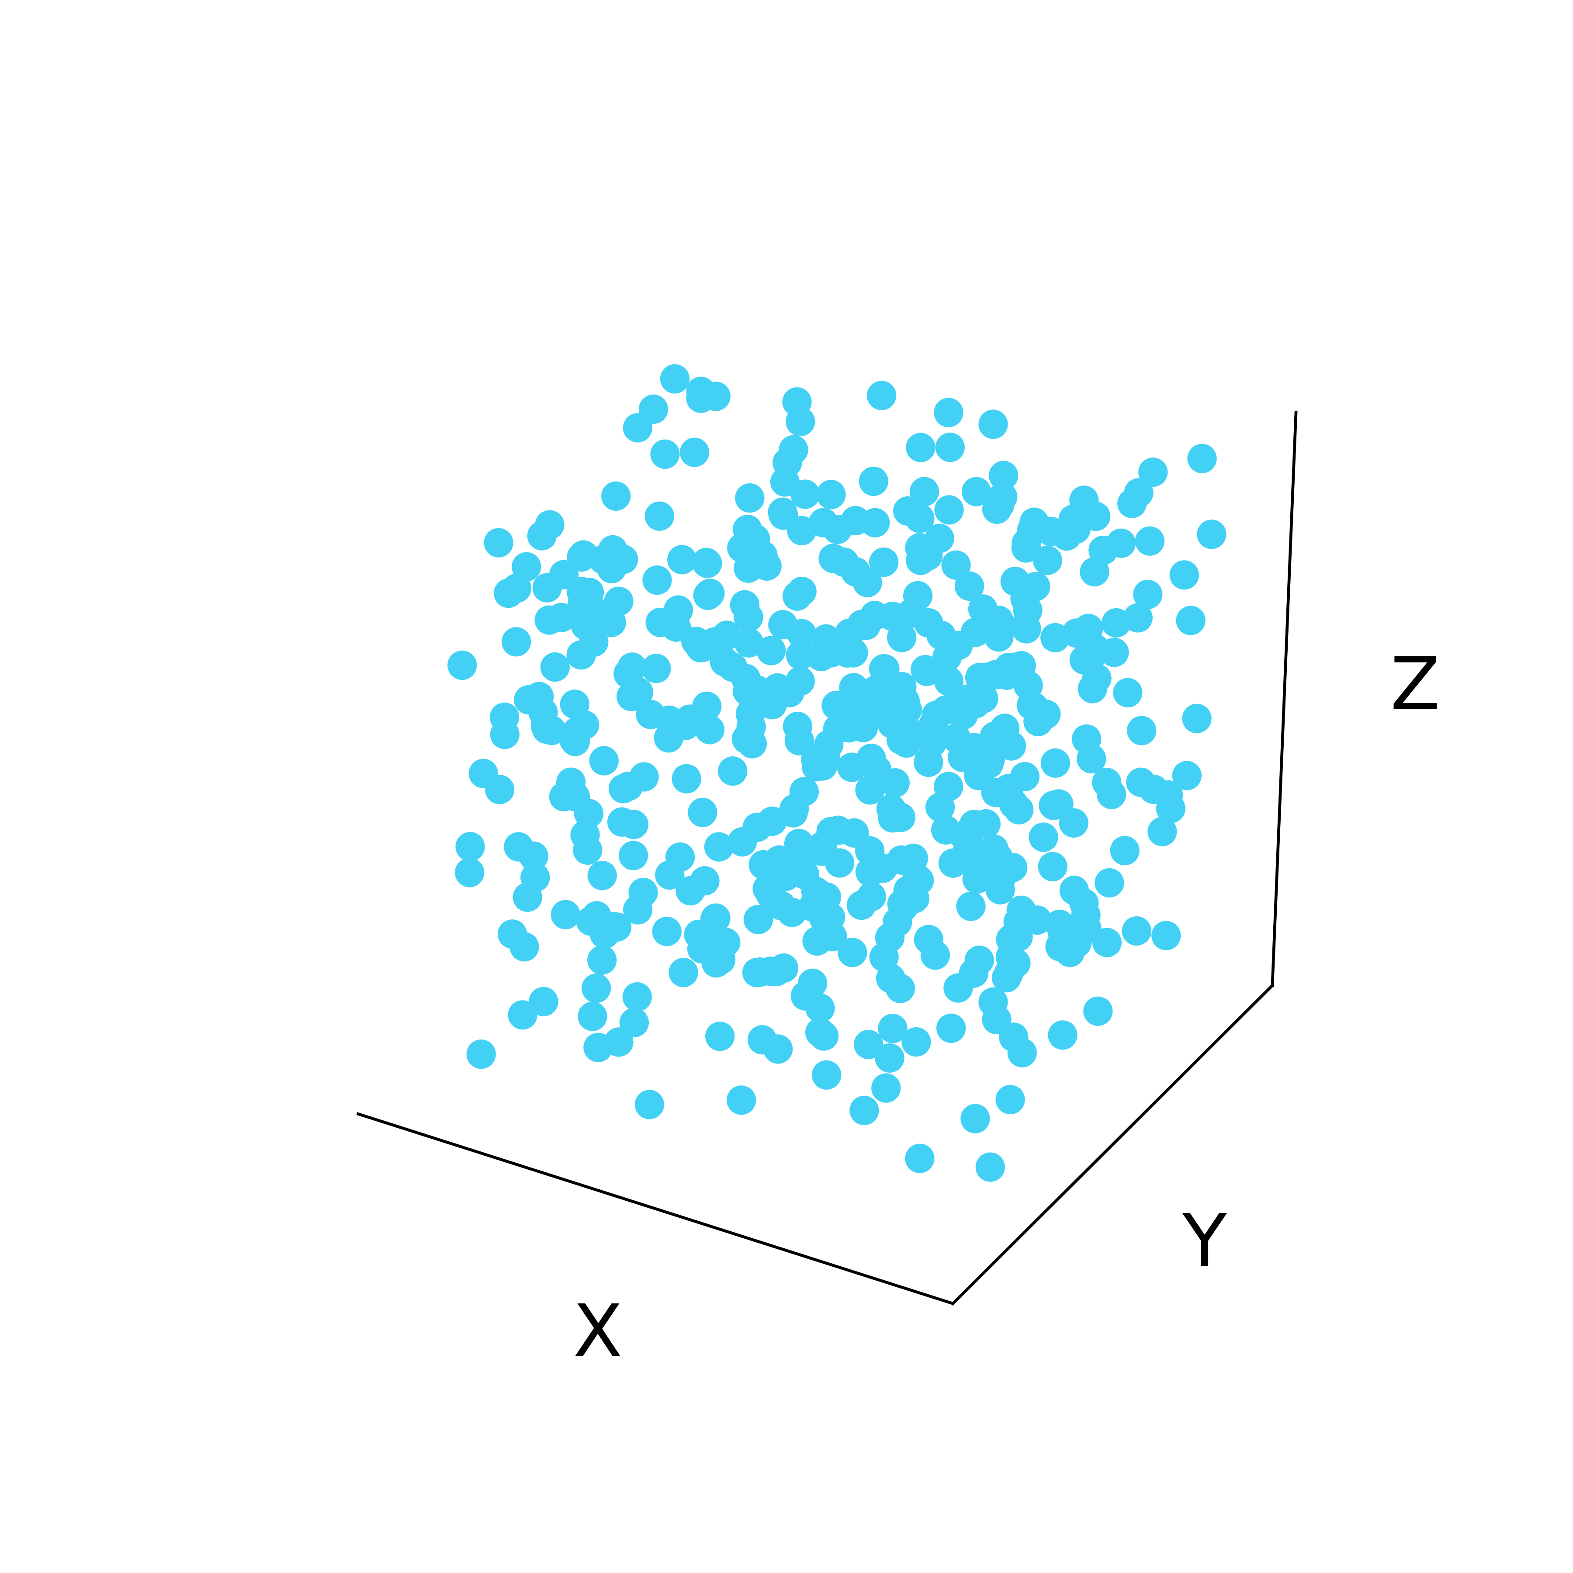
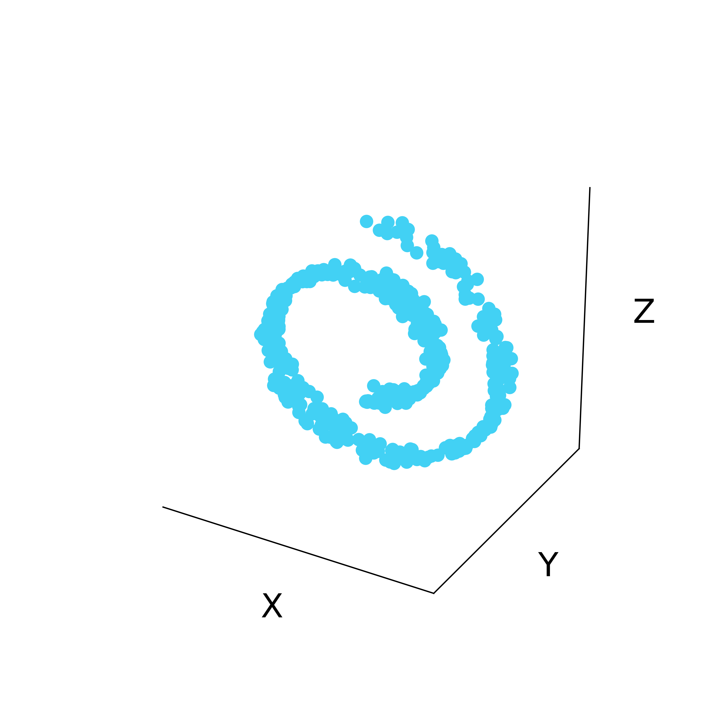
Latent structure in high dimensional data
Low-dimensional
manifold
Ambient Space

Slide 7
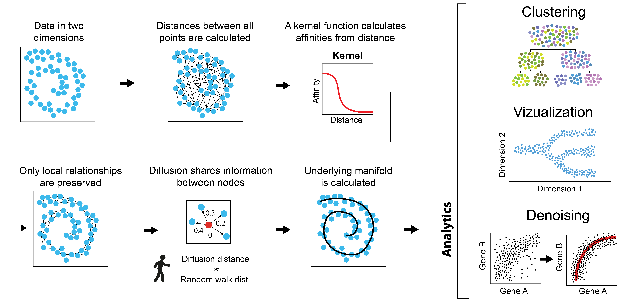
How do we learn the shape of data?
Notes:
Global distance is not reliable, but local Euclidean steps are
We can use local Euclidean steps to “diffuse” through the manifold
Diffusion is equivalent to a random walk

Slide 8
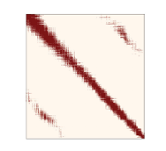
Affinity Matrix contains Manifold Information
Regardless of Markov normalization
Graph Adjacency Matrix contains the information about the manifold

Slide 9
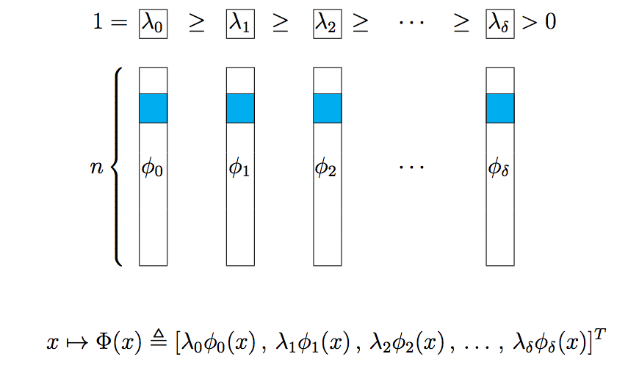
Revealed by Eigendecomposition
[Coifman, Lafon, ACHA 2006]

Slide 10
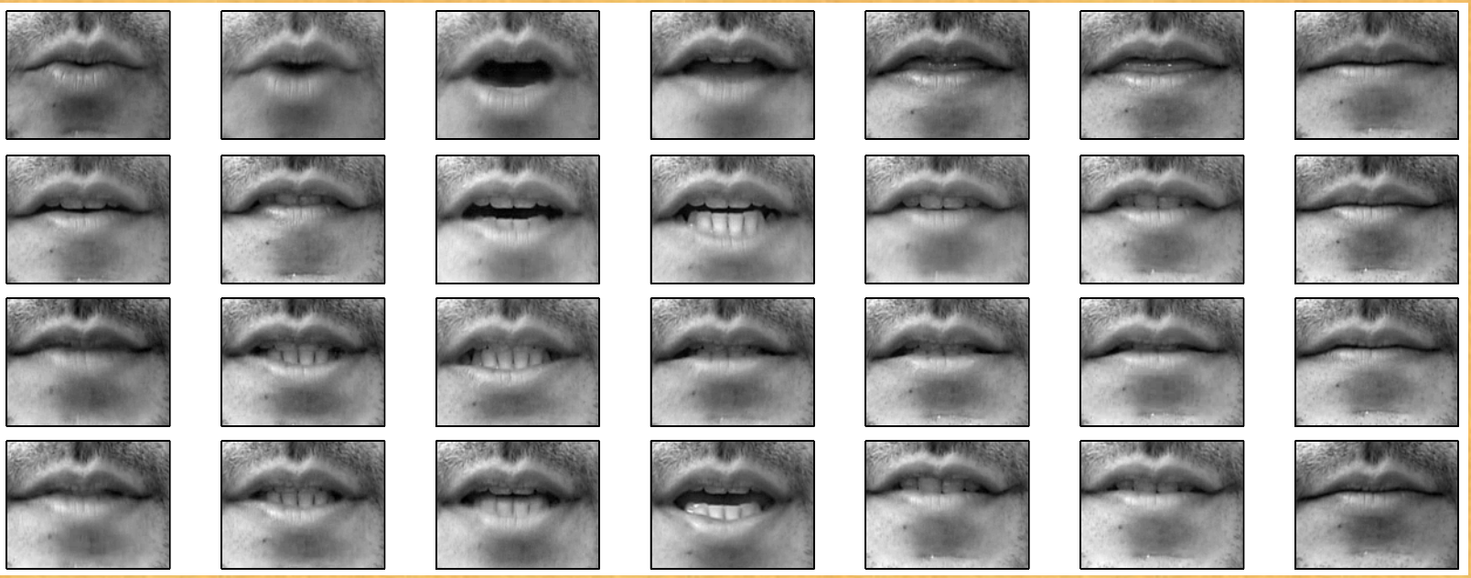
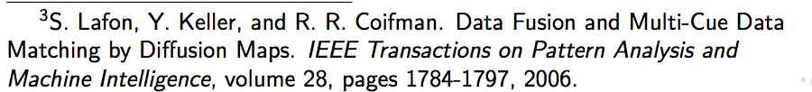
Lips Dataset: Spoken Digits
ONE

Slide 11
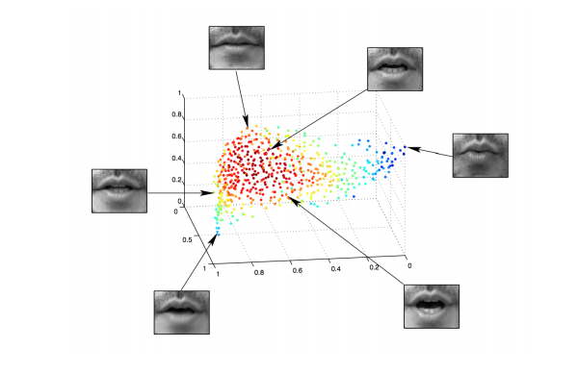
Lips Manifold Diffusion Component

Slide 12
Non-Linear Dimensionality Reduction
Almost always uses the graph affinity matrix
Sometimes involves eigendecomposition Laplacian eigenmaps
Diffusion maps
Sometimes involves preserving information from graph in another way
tSNE: Preserves nearest neighbor probabilites from Markov Affinity matrix in 2D using a randomized algorithm
PHATE: Preserves probability-distribution distances from diffused Markov affinity matrix in 2D using MDS

Slide 13
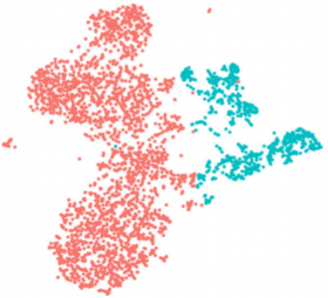
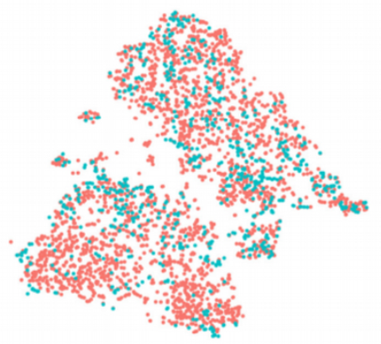
Other uses of affinity matrices, eigenvectors
Data Denoising
Batch normalization
Clustering
Data denoising and batch normalization
Clustering

Slide 14
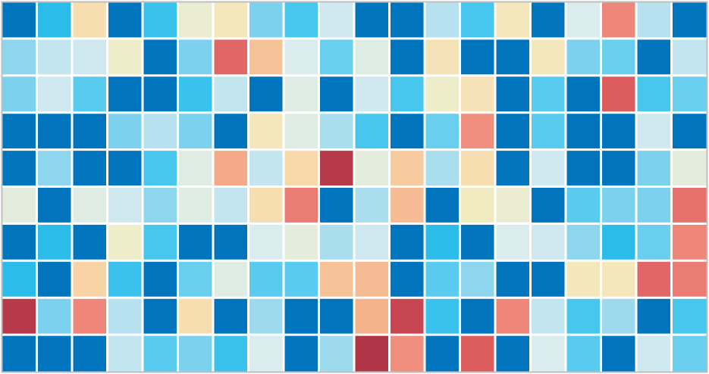
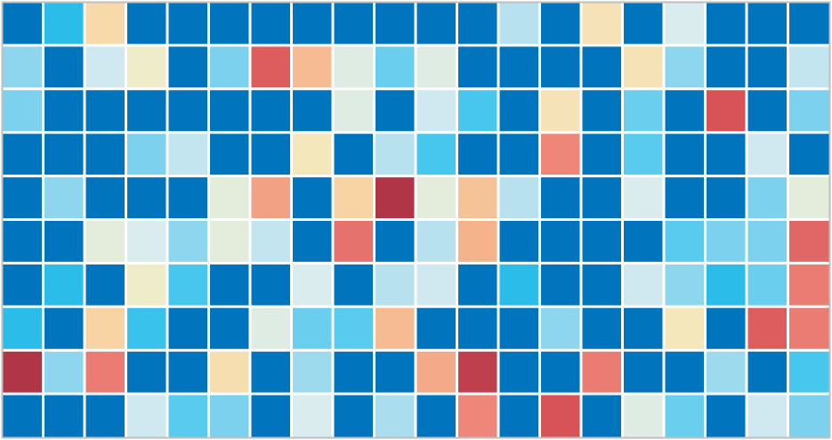
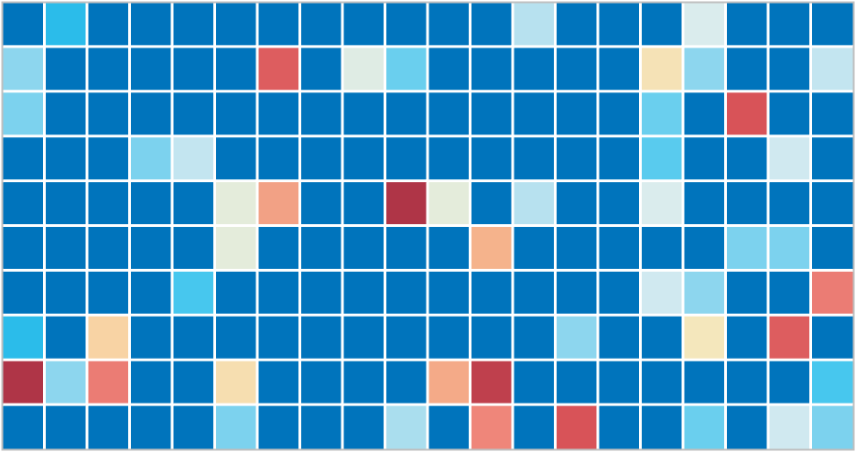
Genes
Cells
Data is noisy and sparse (scRNA-seq)
Notes:
ideally: measure the expression of every gene in every
Samples only a small part of the transcriptome per cell
-- Tens of millions of individual measurements

Slide 15
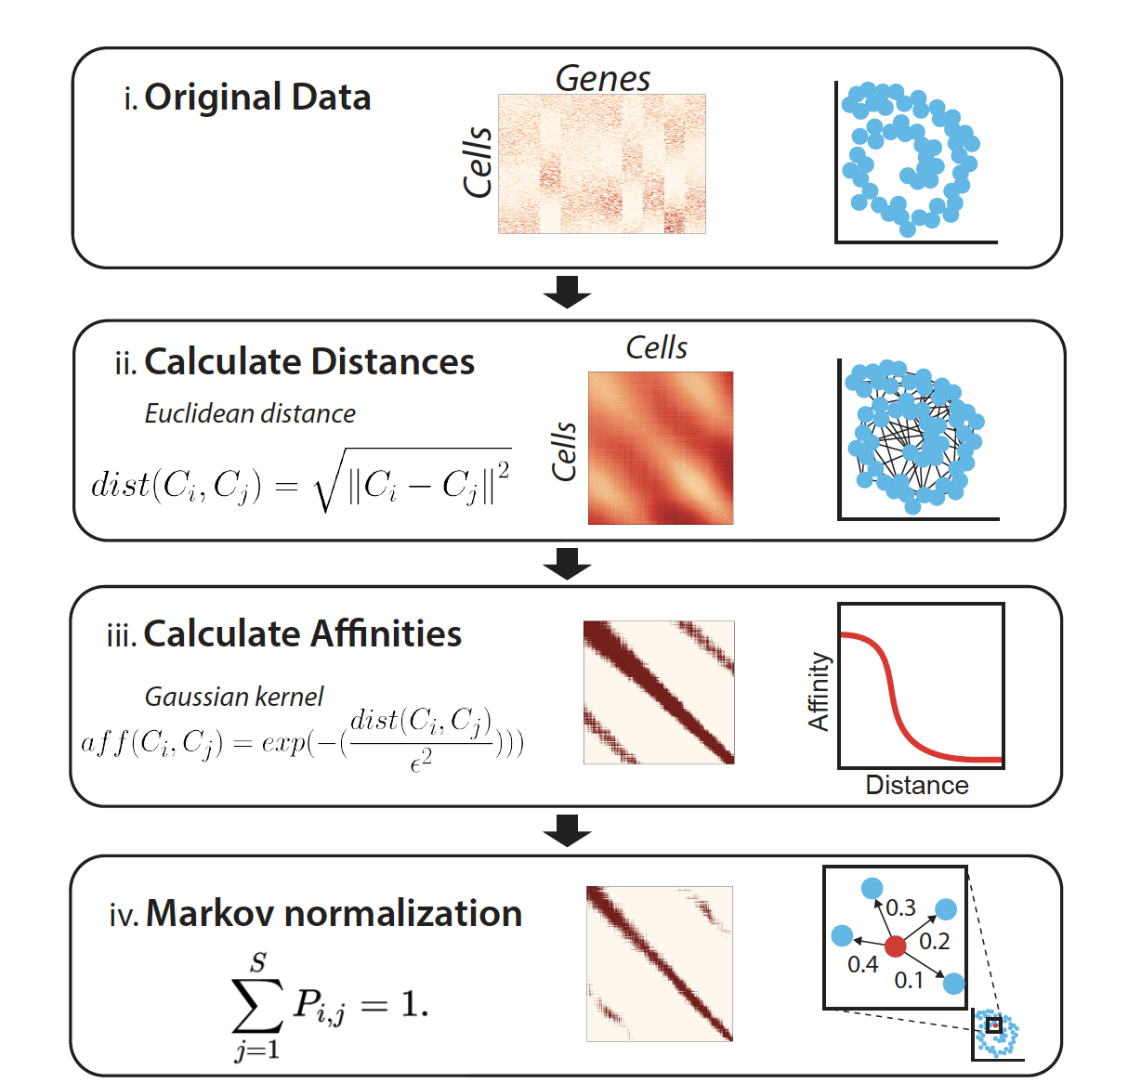

Slide 16
Eigenvectors of Affinity Matrix

Slide 17
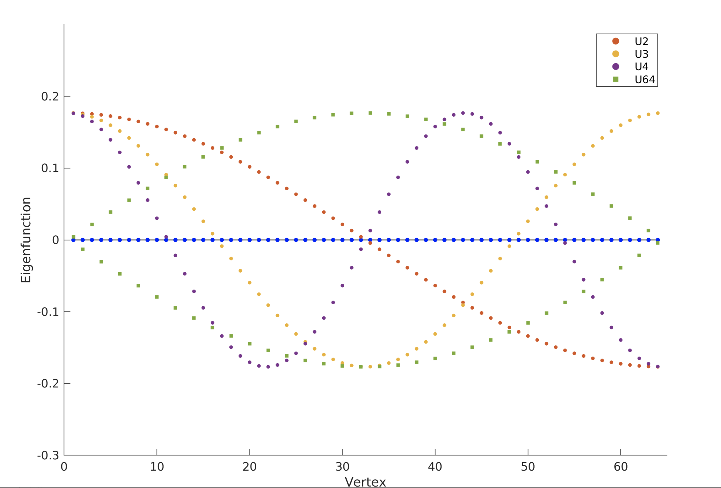
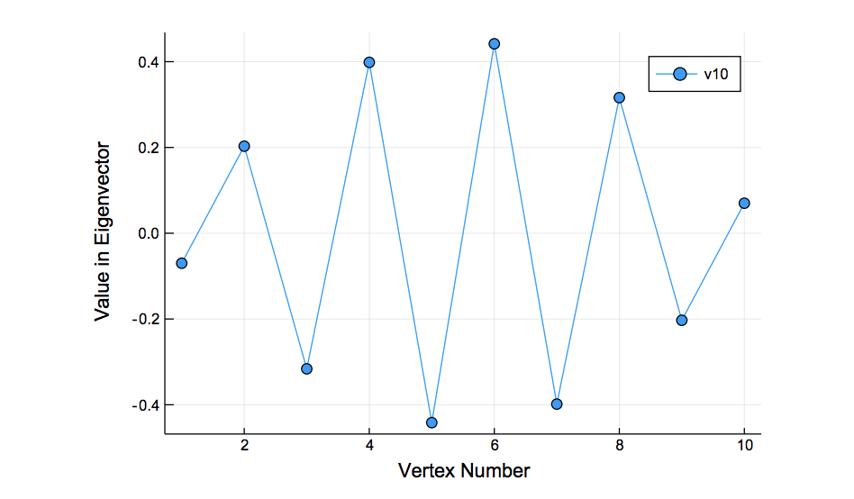
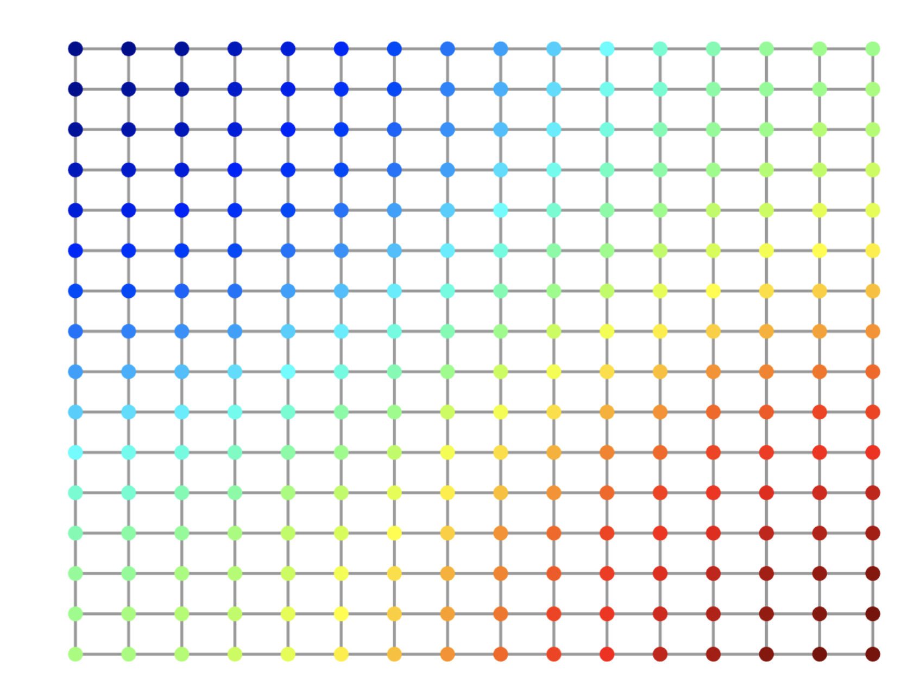
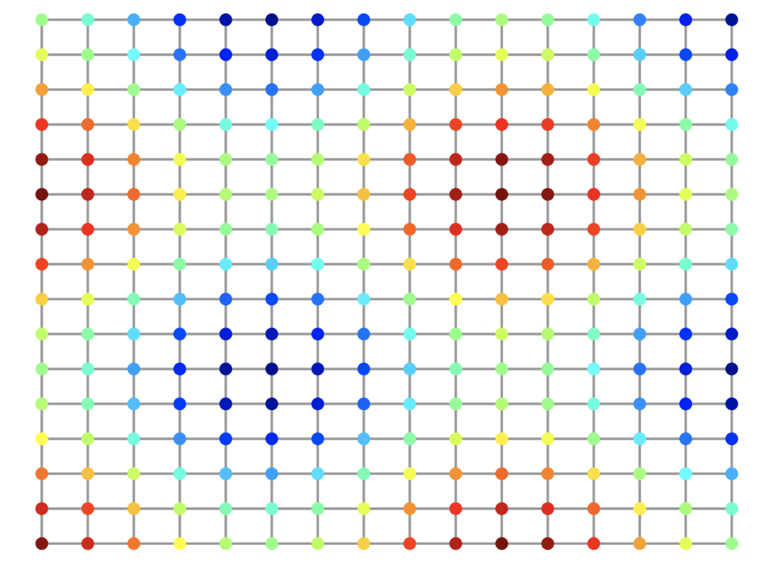
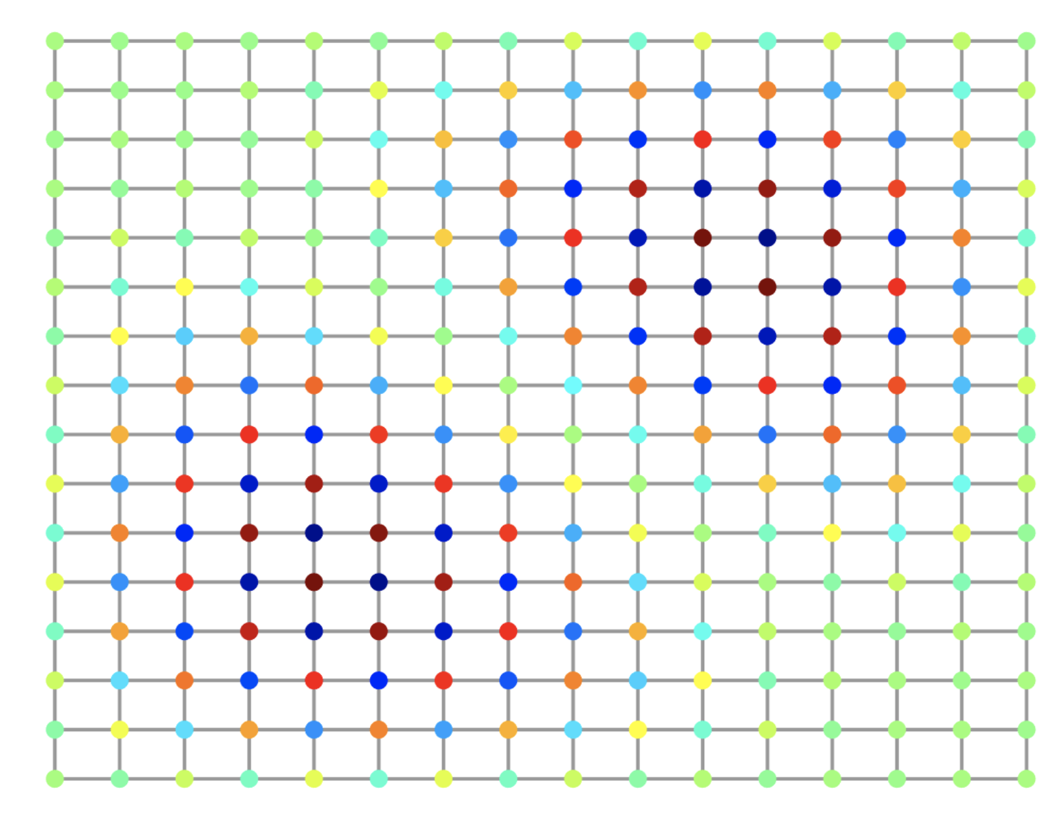
Eigenvectors are frequency harmonics
2nd Eigenvector
10th Eigenvector
2nd to last eigenvector

Slide 18
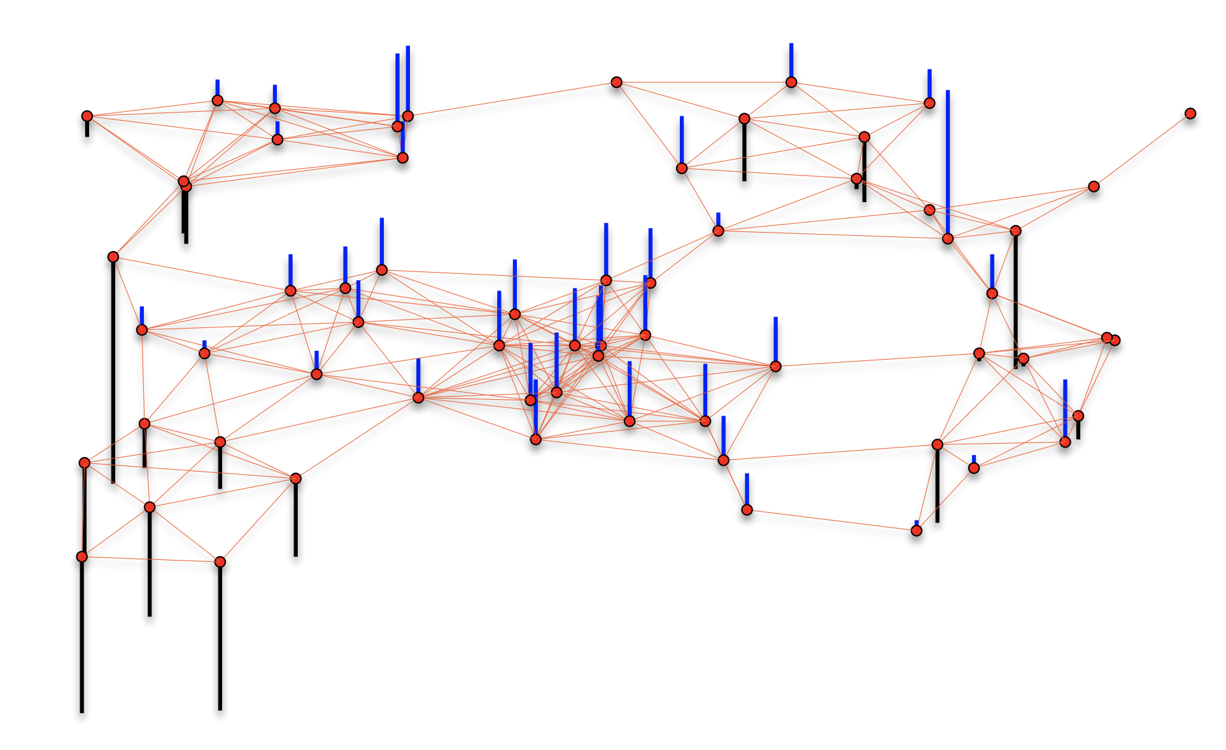
Cells are nodes, mRNA gene-counts are signals on a graph

Slide 19
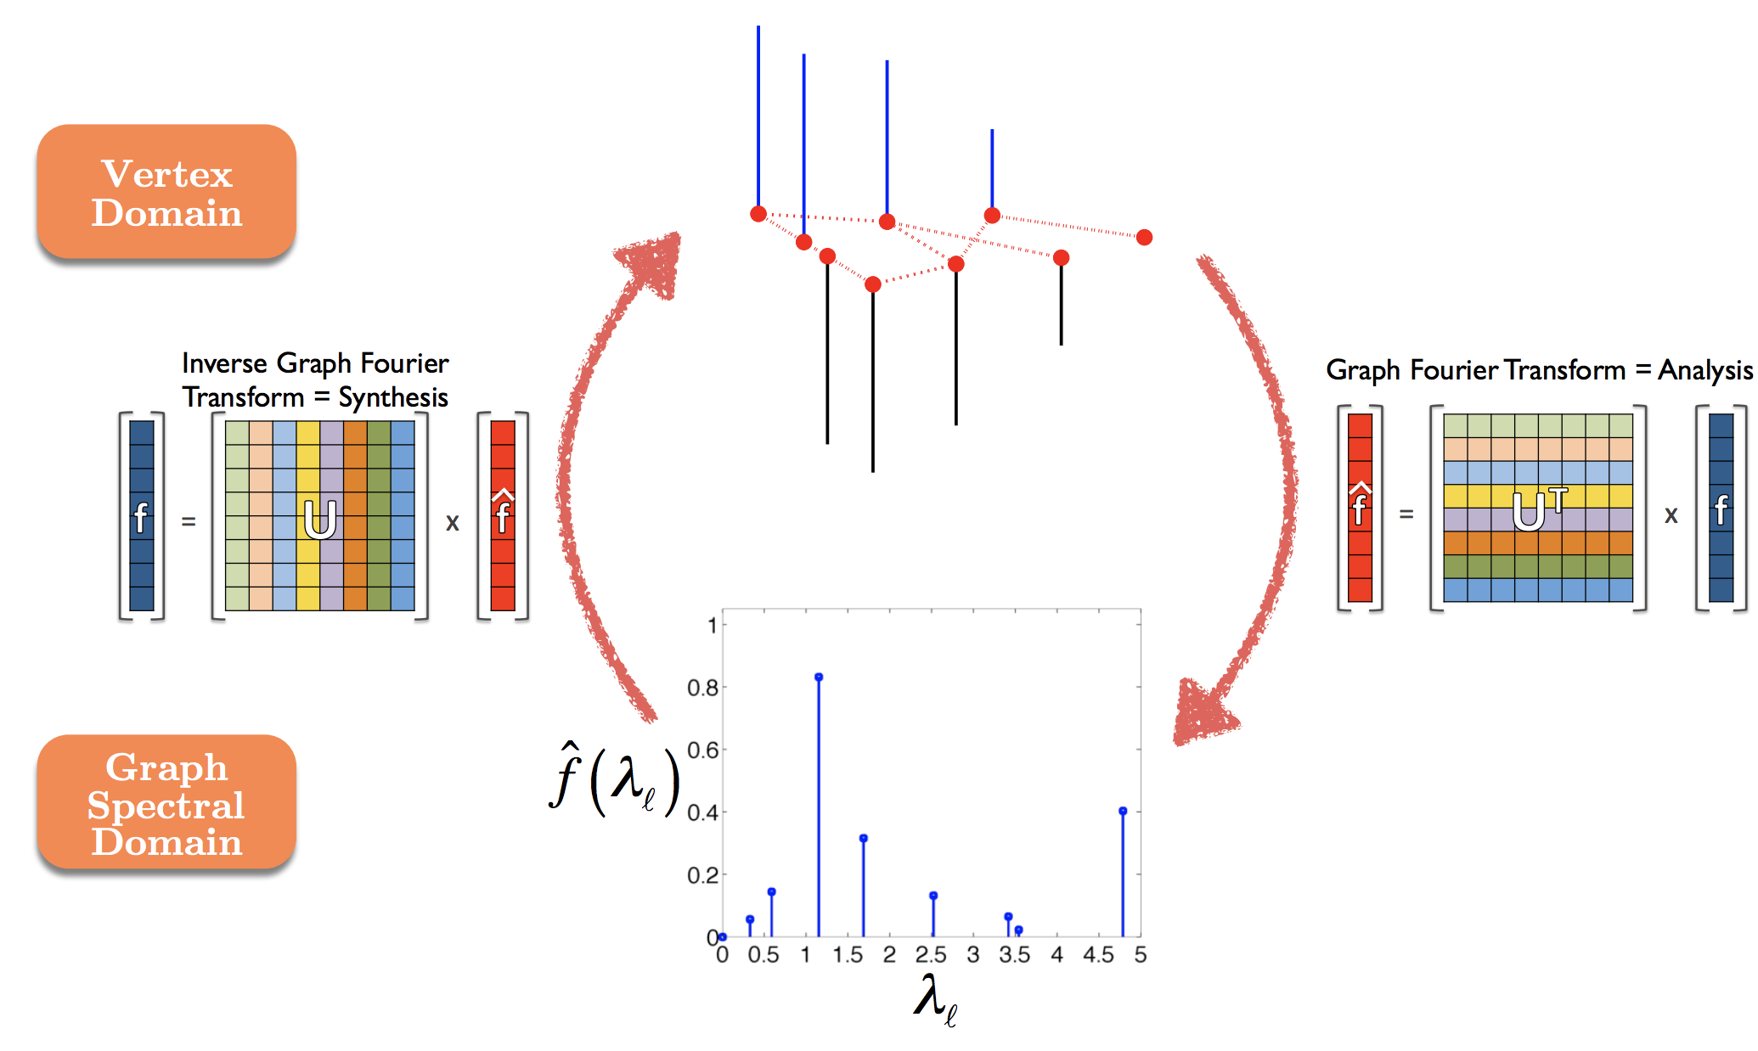
Graph Fourier Transform

Slide 20
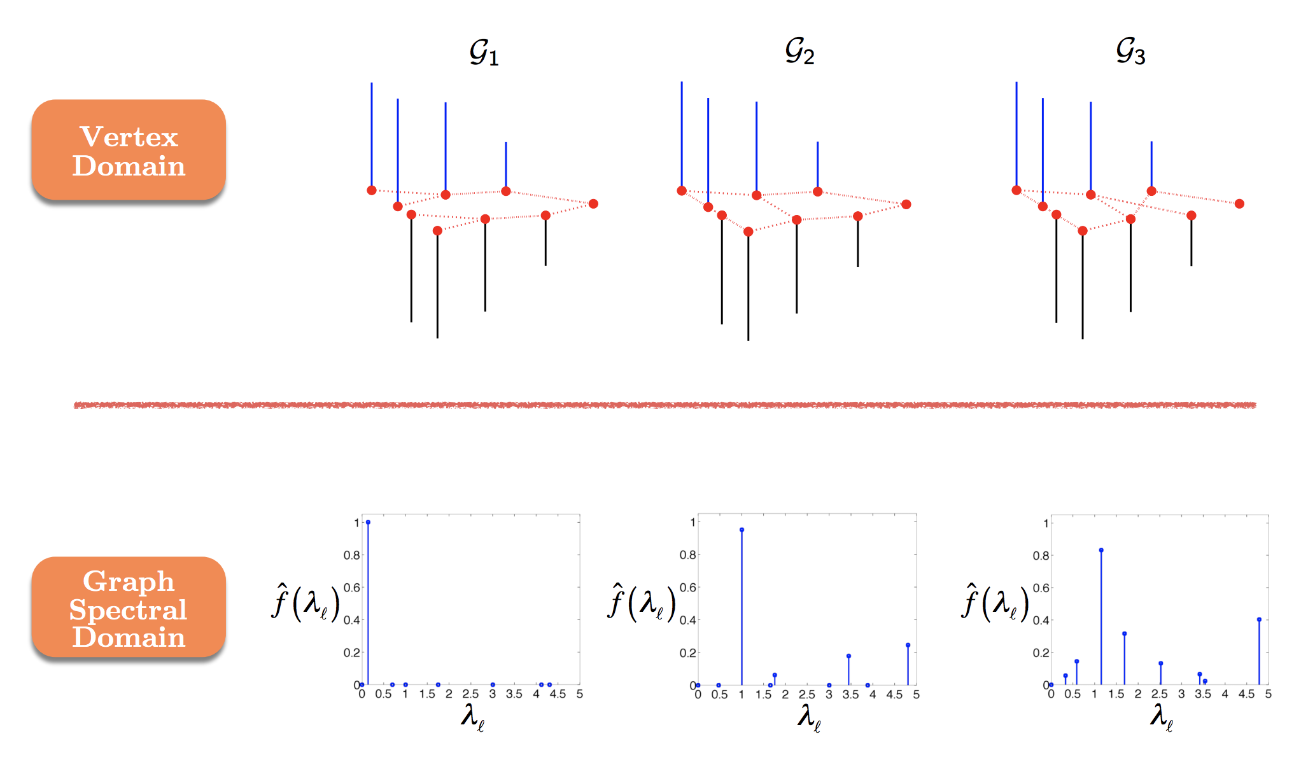

Slide 21
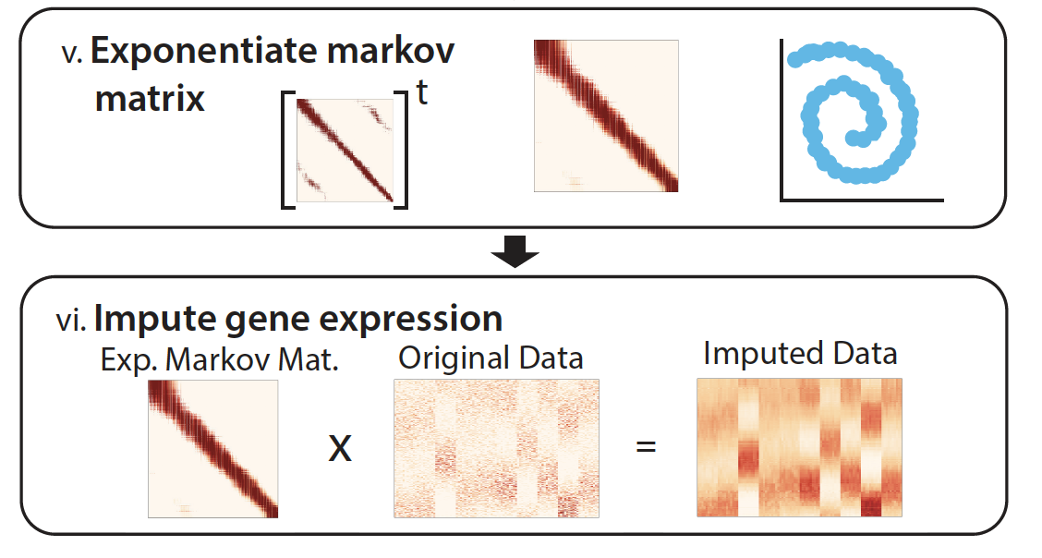
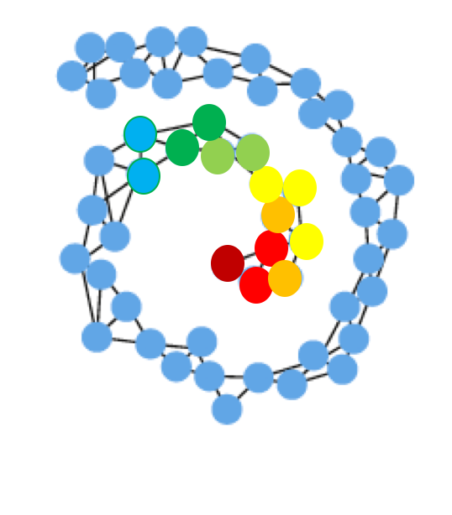
Imputation Step = Smoothing on Graph

Slide 22
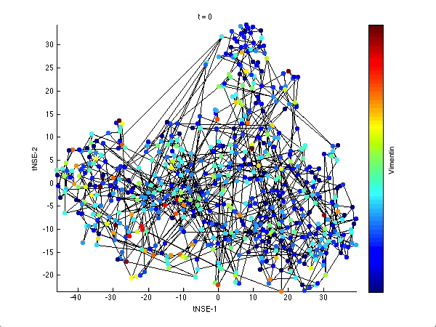
Vertex Domain
Smooths signal on graph
Takes weighted average of neighbor

Slide 23
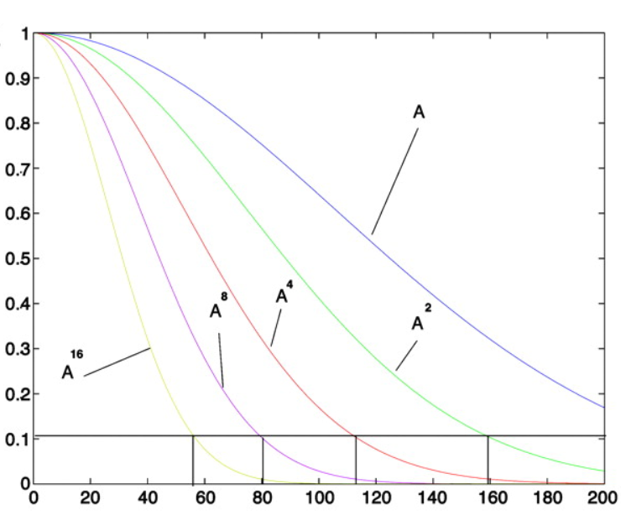
Low pass filter of Eigenvectors

Slide 24
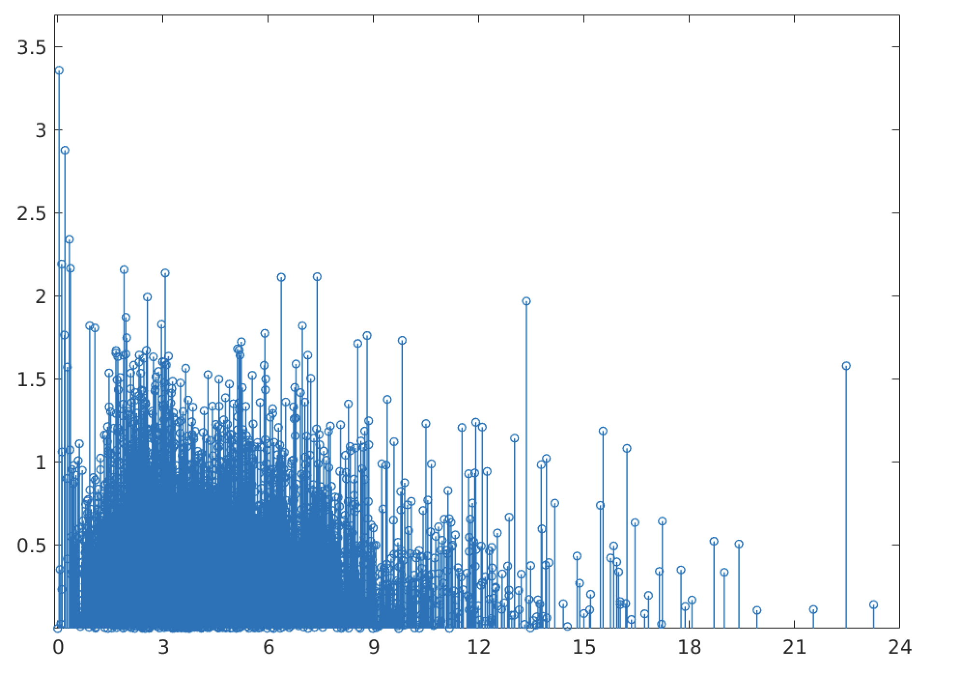
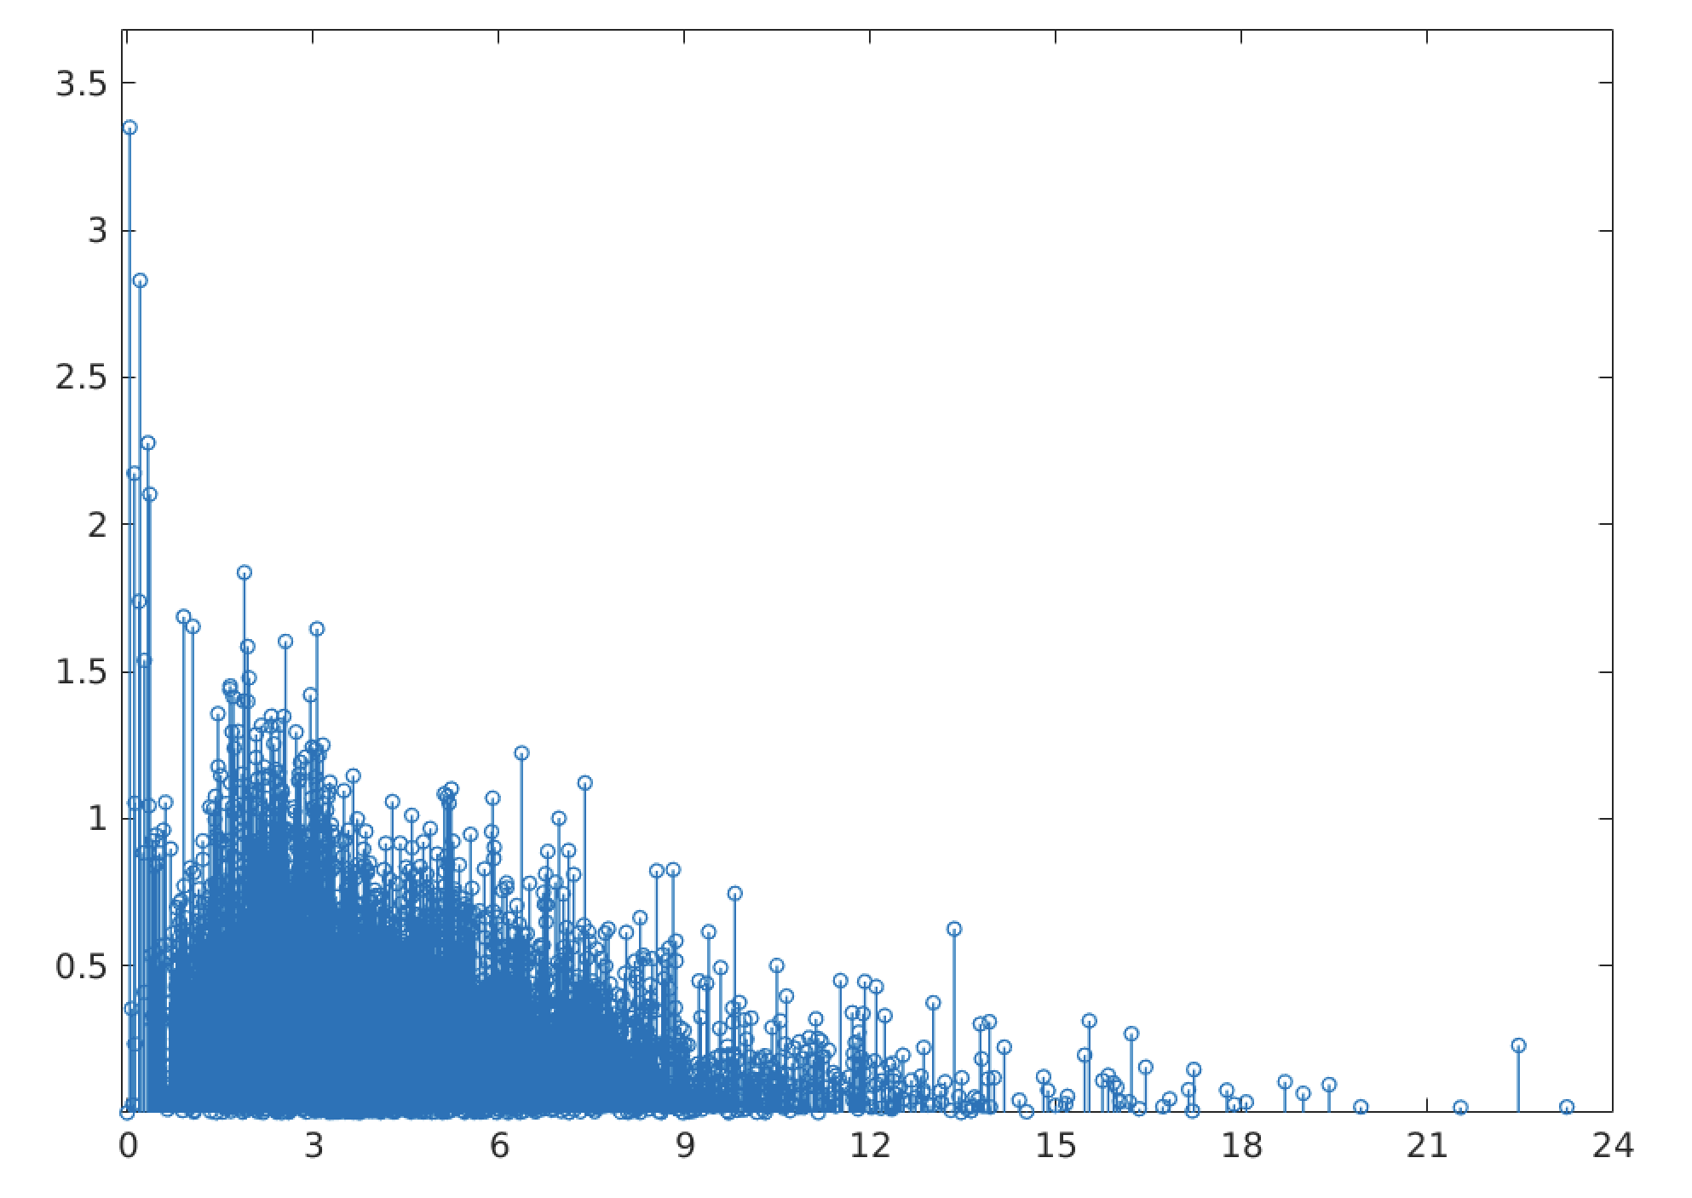
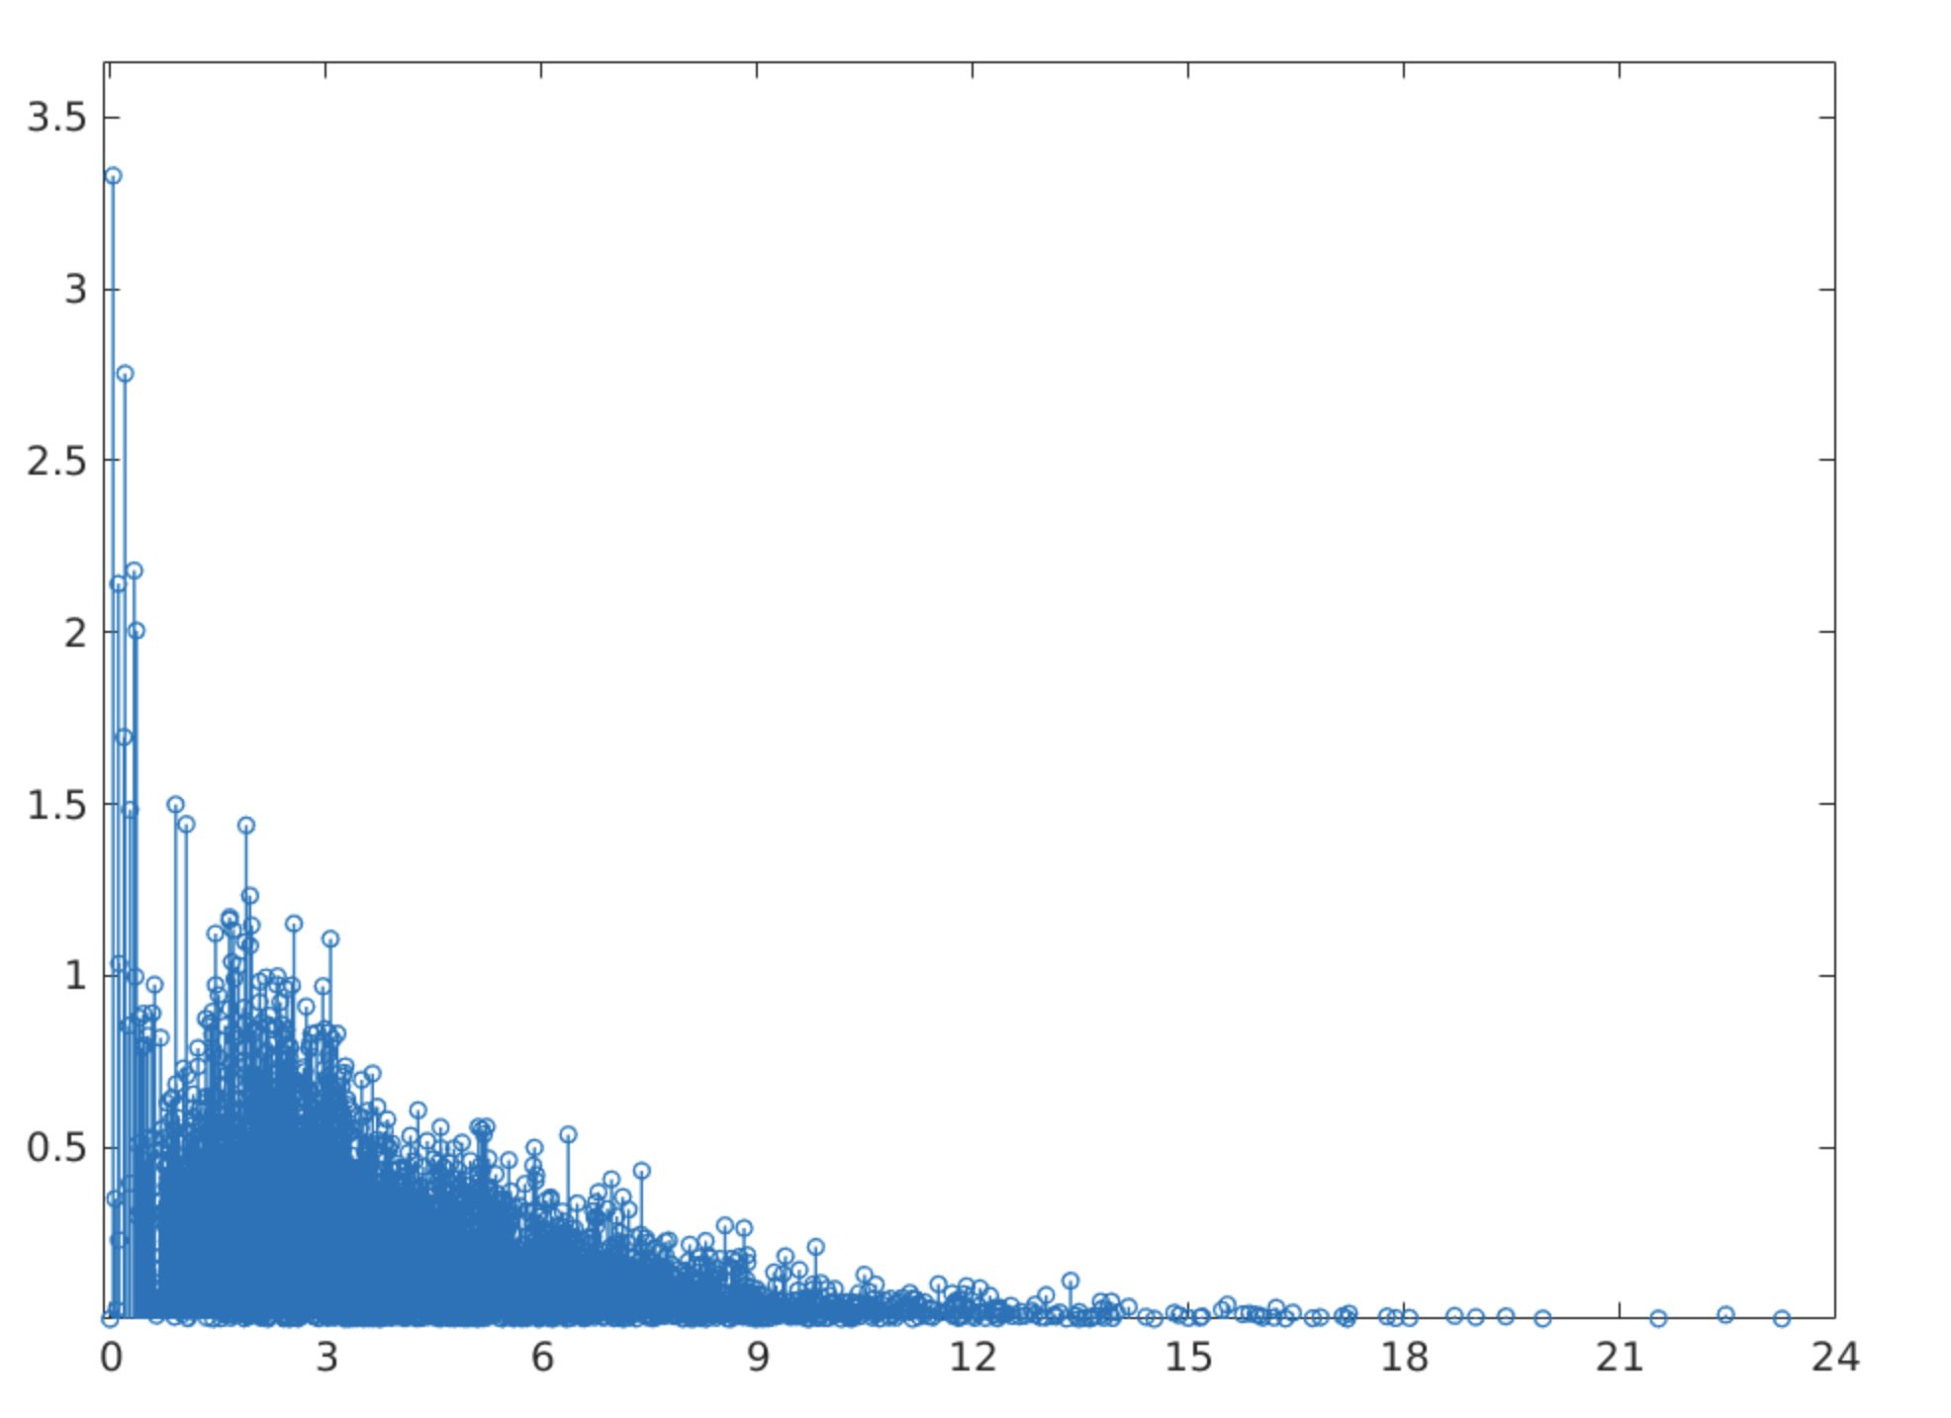
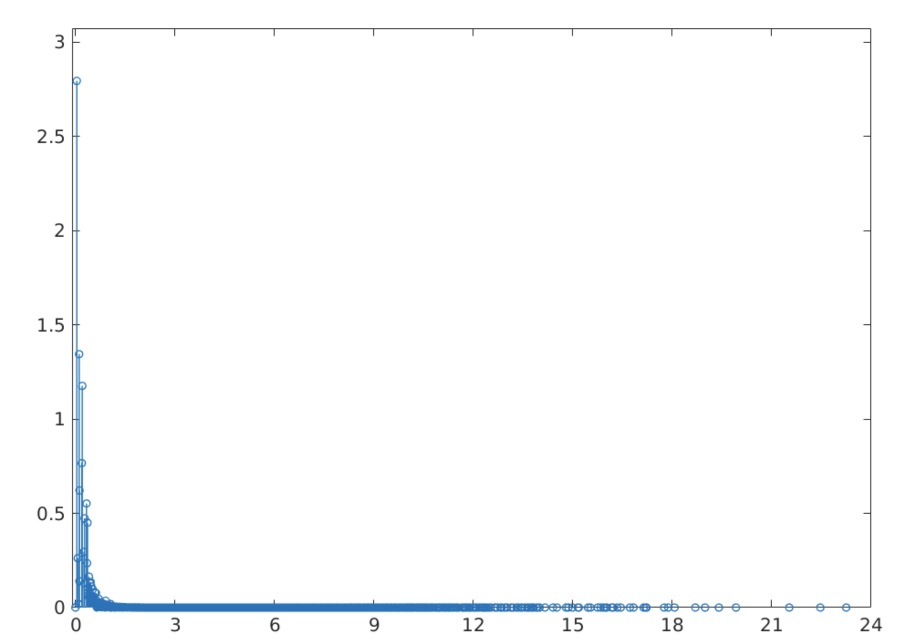
Frequency domain
No Smoothing
T=2
Kills high frequency
noise
T=5
T=100

Slide 25
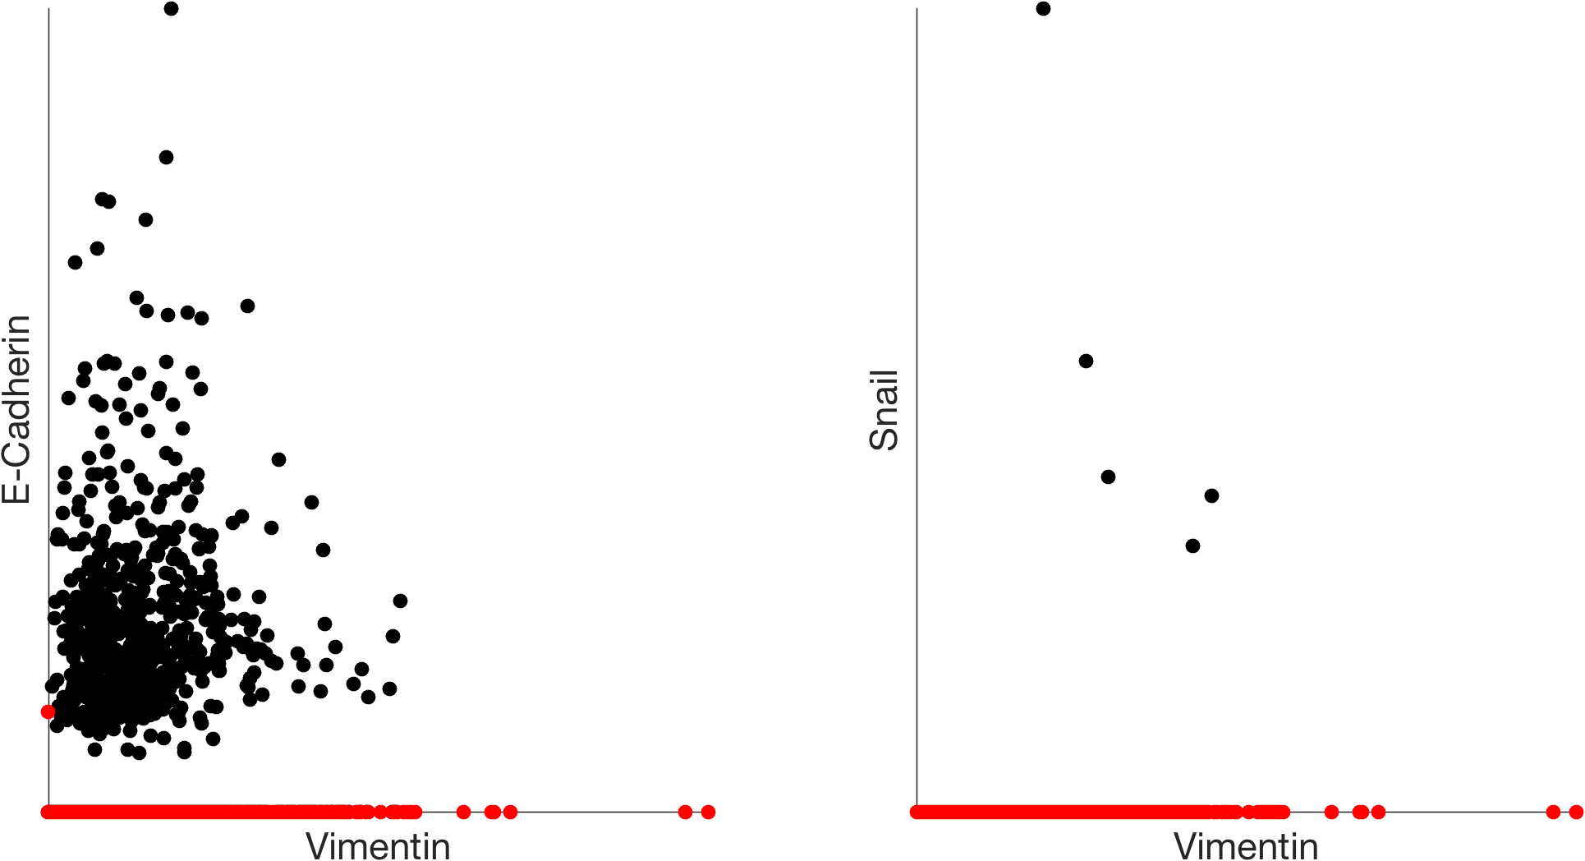
missing values
original data with dropout

Slide 26
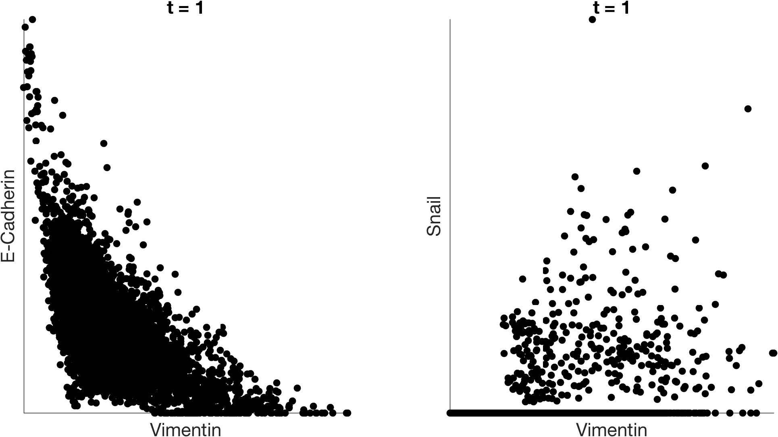
imputation with MAGIC

Slide 27
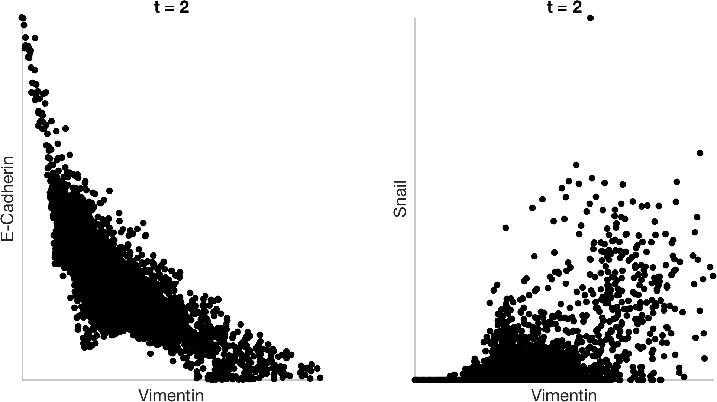
imputation with MAGIC

Slide 28
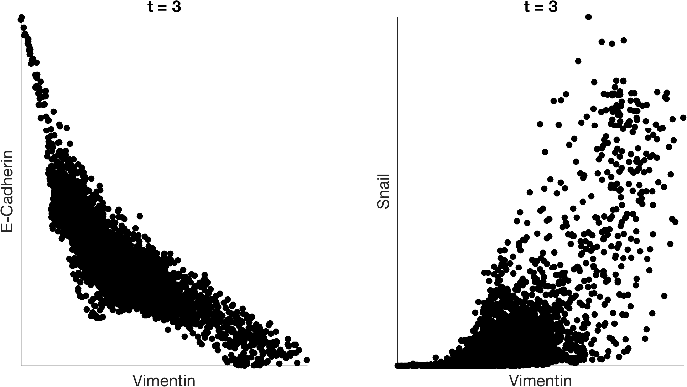
imputation with MAGIC

Slide 29
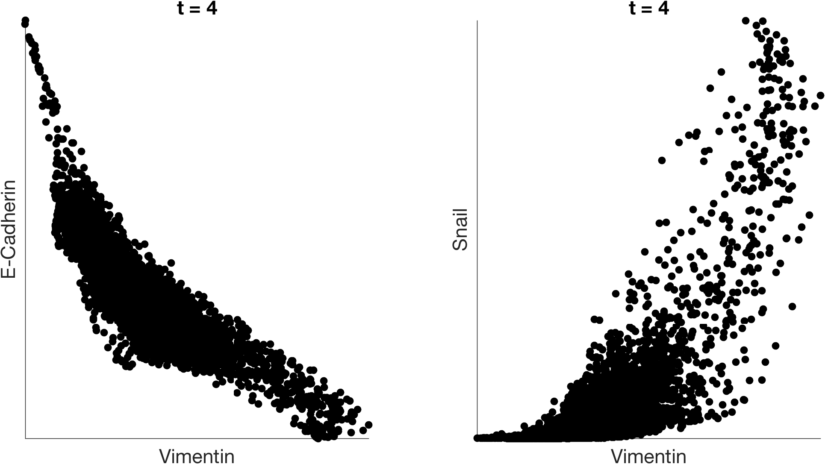
imputation with MAGIC

Slide 30
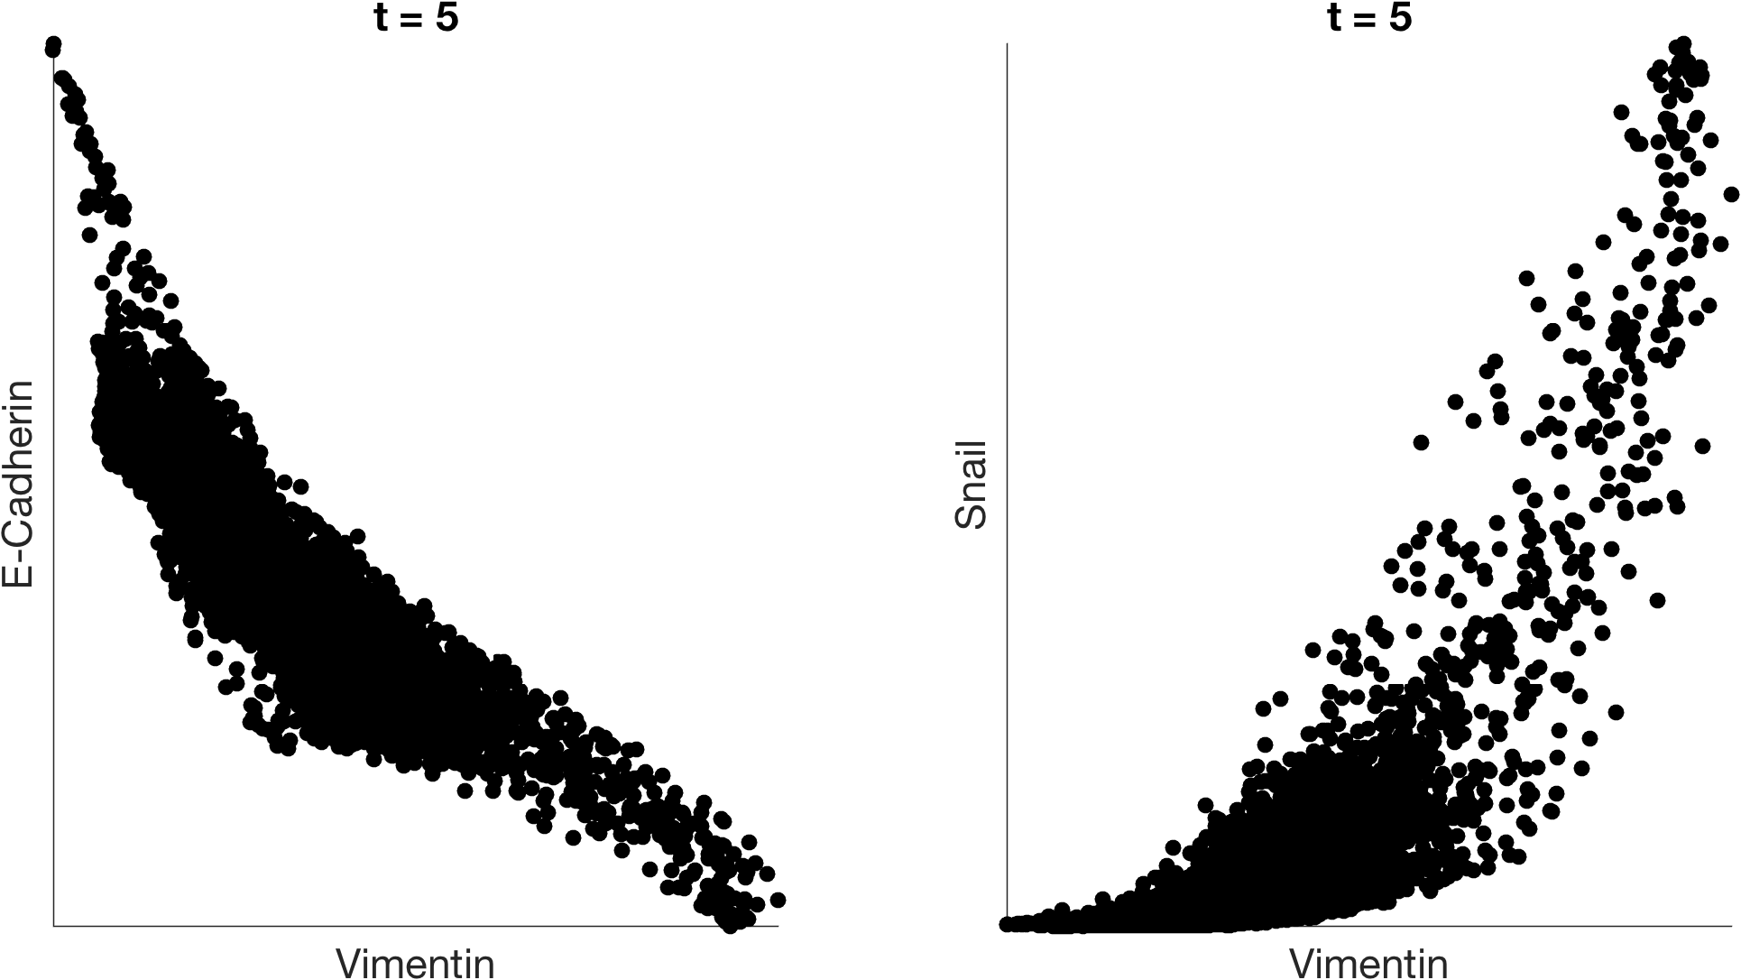
imputation with MAGIC

Slide 31
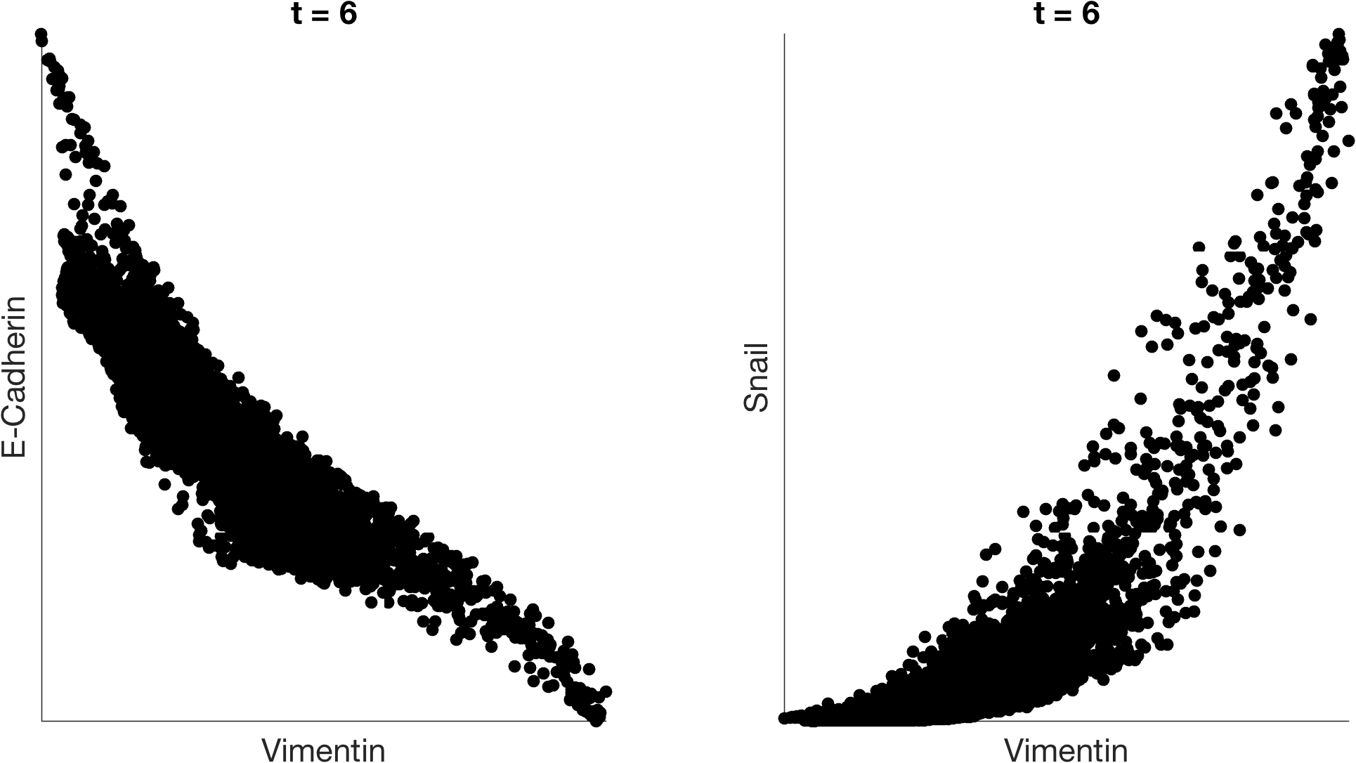
imputation with MAGIC

Slide 32
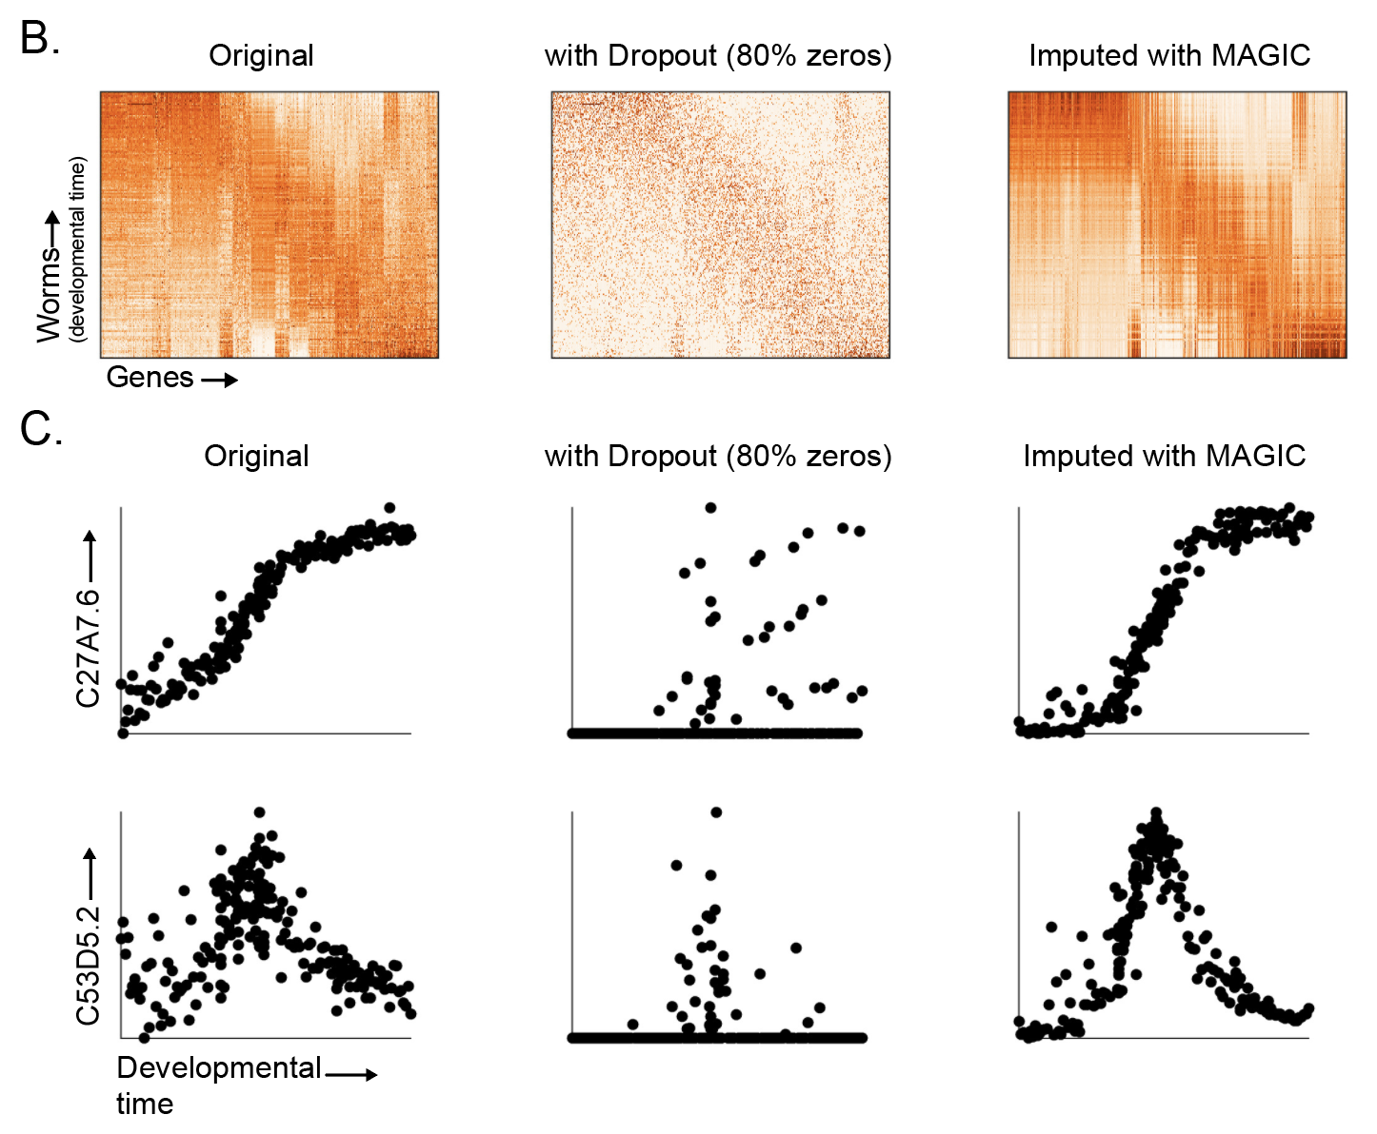
MAGIC recovers gene-gene relationships in an artificially dropped-out dataset

Slide 33
Summary of data denoising
Diffusing or smoothing values over a graph can denoise data
This kind of denoising is similar to averaging expression values across neighbors
More diffusion = more denoising
What questions do you have?
Please submit on Slack

Slide 34
Batch correction
Notes:
TA introduction
Talk about not teaching code (not a programming workshop)

Slide 35
Batch Effect in Single Cell Data
Systematic, non-biological differences between
samples due to measurement conditions
Differences could be due to ambient conditions
(temperature, humidity), machine calibration,
differences in titration, bead/antibody batch, etc
Sometimes refers to actually actual biological
differences but those that are “uninteresting” (background demographics rather than immediate drug effect).

Slide 36
Problem with Batch Effect
Samples become hard to compare
All genes, cell types seem different!

Slide 37
Batch Correction
Take off artifactual variation and keep biological variation!

Slide 38
Batch correction methods
Several batch correction methods exist but all have drawbacks
CCA : uses a variant of PCA that brings two sets of samples to a common space
Can cluster or perform other analysis in common space but cannot go back to original space
Finds linear axes of common variation
Thrown off by non-matching populations
Harmonic Alignment: Aligns diffusion dimensions instead of PCA dimensions, uses MAGIC to go back to original space
Aligning diffusion components is difficult, currently limited to rigid rotations of diffusion space
We’re working on it!

Slide 39
Mutual Nearest Neighbors
Creates a graph between two datasets
Nearest neighbors in the other dataset could be “matching cells”
But they have to be mutual!
Mutual neighbors
Non-mutual neighbors

Slide 40
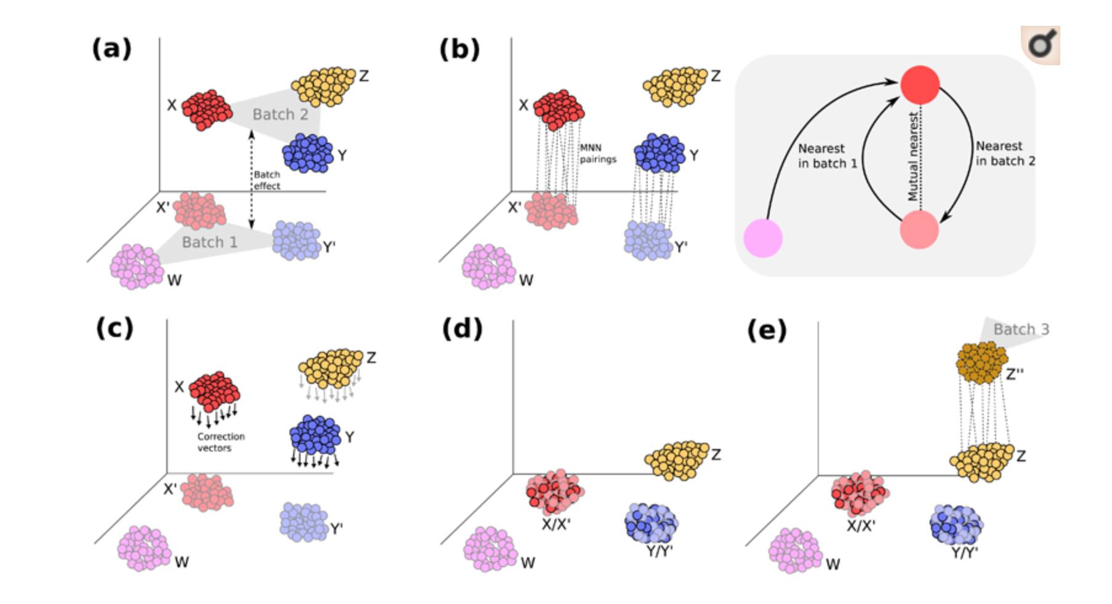
Mutual Nearest Neighbors
Use MNNs to find out the direction of the batch effect and correct it.

Slide 41
MNN with MAGIC
B1
B2
Within 1
From 1->2
From 2->1
Within 2
Uses softer affinity matrix and pulls the data in to correct the result

Slide 42
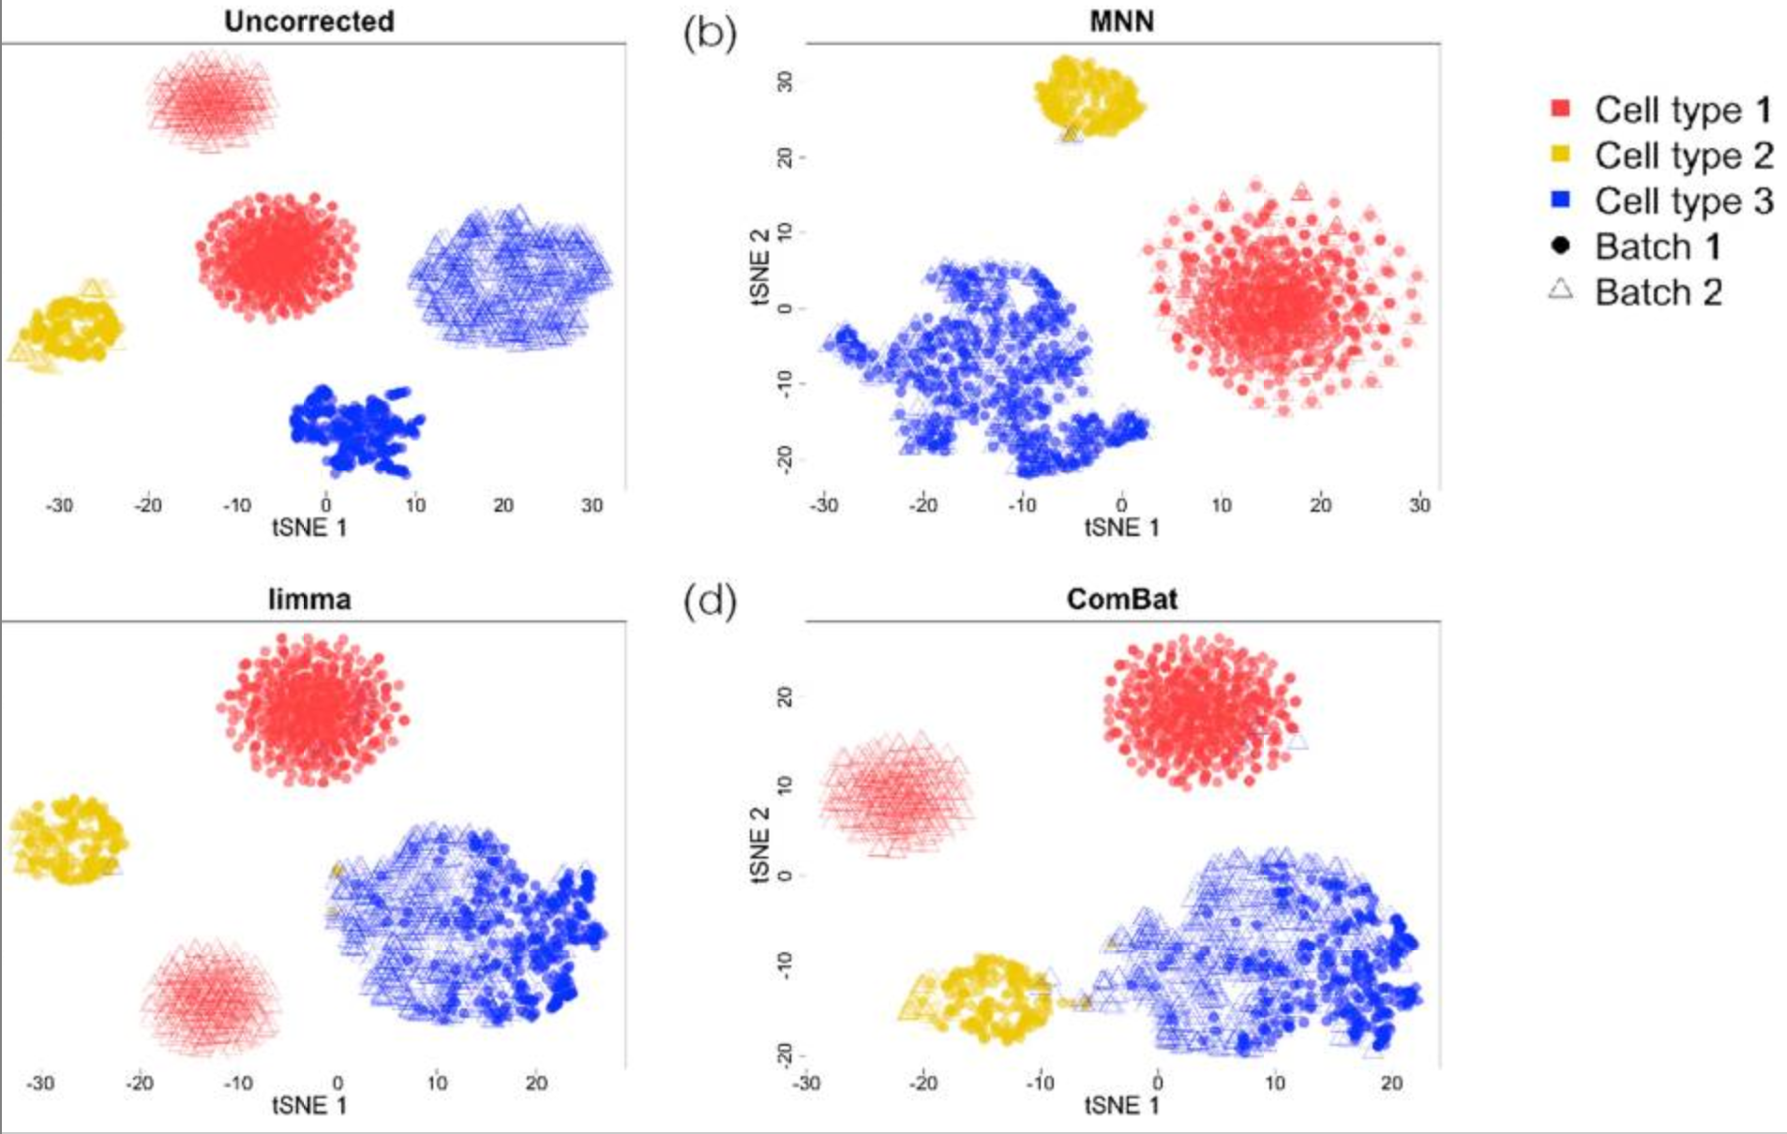

Slide 43
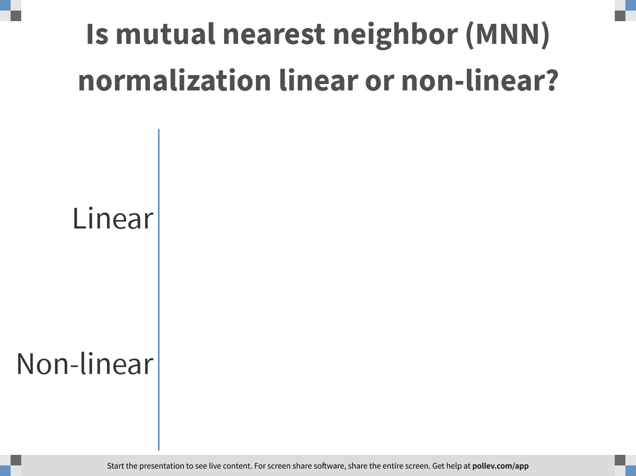
Notes:
Is mutual nearest neighbor (MNN) normalization linear or non-linear?
https://www.polleverywhere.com/multiple_choice_polls/mnsSK1uYGDPag7UUXFzhc

Slide 44
Summary of data denoising
Batch effects are sample-specific changes in measurements
The goal of batch-normalization is to align cells of the same “type” across samples
Mutual nearest neighbors (MNN) normalized batches by matching cells that are both close to each other
What questions do you have?
Please submit on Slack

Slide 45
Clustering
Notes:
TA introduction
Talk about not teaching code (not a programming workshop)

Slide 46
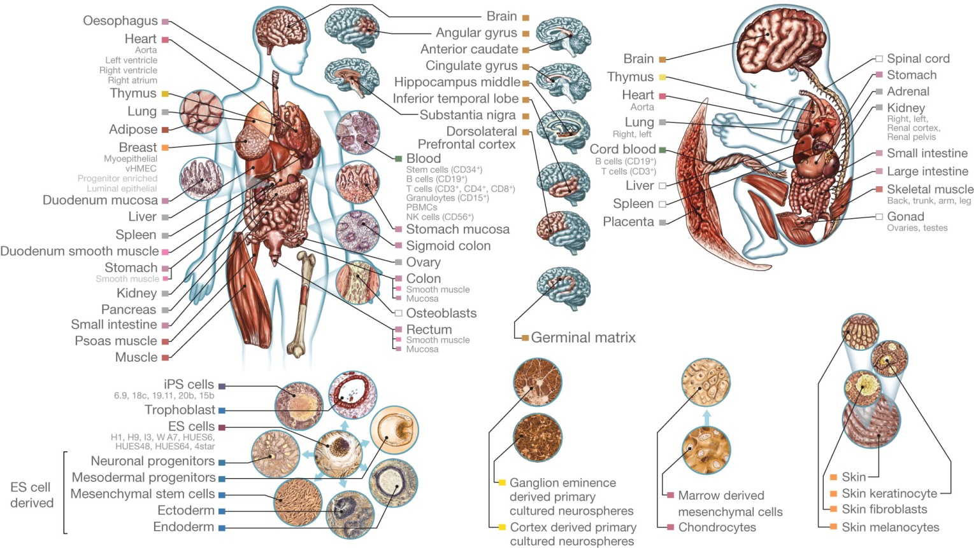
The human body comprises untold cellular diversity
High Degree of Complexity
Roadmap Epigenomics Consortium Nature 2015
Notes:
The number of cell types is QUANTITY for which ONLY ESTIMATES.
“List of distinct cell types in the adult human body” ~220 cell types.
Is this number essential?
May seem obvious, but defining CELL TYPE precisely, is not straight forward, open to revision
Even looking at just one system, the blood and the bone marrow niche that generates it, still new facets.

Slide 47
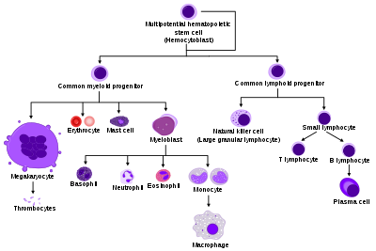
Phenotyping in Biology

Slide 48
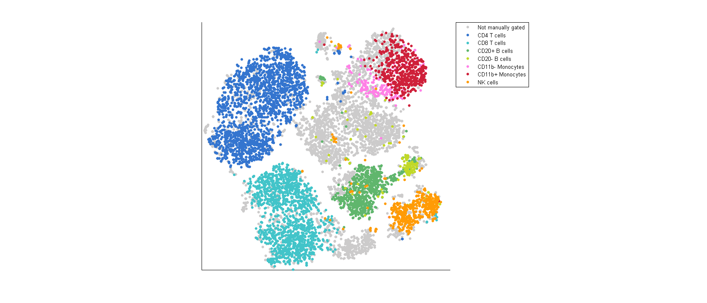
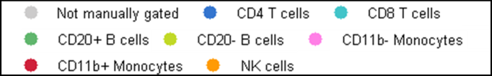
tSNE Map of Immune Cells
van der Maaten JMLR 2008, 2014
Amir et al. Nat. Biotech 2013
Notes:
This is what we would want to see.
Cell types are well separated
We can see additional structure that is missed by the manual gating

Slide 49
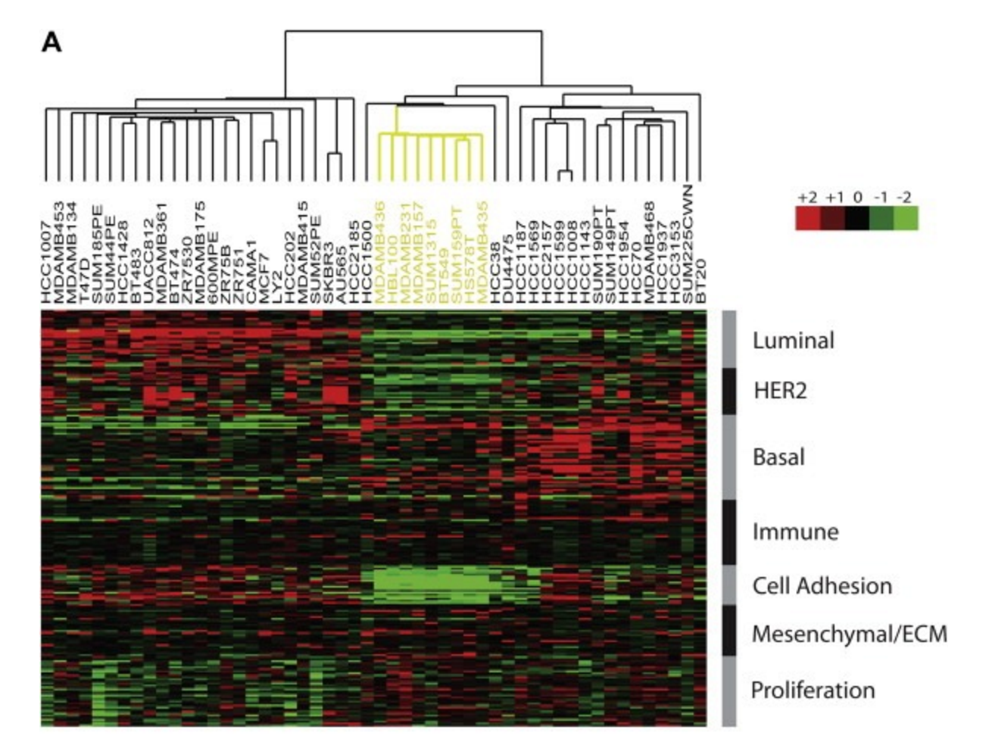

Breast Cancer Subtypes

Slide 50
Clustering Used in Many Ways in Biology
Clustering gene expression profiles to find “modules” or groups of genes that work together
Clustering patient data to see if patients have similar disease
Clustering cells to find different cell types

Slide 51
What is clustering?

Slide 52

Grouping of Similar Objects
Linkage Clustering, Community detection

Slide 53

Density Centers
DBSCAN, Gaussian Mixture Model

Slide 54

Metastable States in A Manifold
PHENOGRAPH

Slide 55

A partitioning of the data space
Voronoi Diagram
K-MEANS (Macloed 1967), Fidduccia Matheyses

Slide 56
How is the partition picked?
By minimizing different objective criteria
Closeness of members within the group
Distance/Separation between groups
Ratio of the two
Minimum cut of an NN-graph
Other criteria?
Modularity: actual edges/ expected edges

Slide 57


Mean Squared Error
Given data
Partition into k clusters
Such that the within-cluster variance is minimized
$$S=\{S_{1}, S_{2}… S_{k}\}$$

Slide 58
K-Means Clustering
Randomly partition data into k clusters
Update step: Compute the means of clusters
Assignment step: Reassign each x_{i} to cluster S_{j} that has the nearest mean u_{j}
Nearest mean minimizes squared Euclidean distance

Slide 59

Algorithm Iterations

Slide 60
Will this process stop?

Slide 61
Yes: K-means Converges
Why?
Each step LOWERS mean squared error
Update of means lowers variance
Reassignment of points to nearby means lowers variance

Slide 62
What does it converge to?
Generally a local minima.
Sensitive to initial conditions
Methods for initialization:
Forgy: K observations chosen as means
Random Partition: Randomly partitions data

Slide 63

Notes:
Do you think KMeans interations from a given initialization will converge at a single solution?
https://www.polleverywhere.com/multiple_choice_polls/zUnXsAnl2jlUJAHMGDLt6

Slide 64
Limitations of this method
Assumes a shape for the cluster: spectral clustering can help with this
Must give number of clusters: there are methods to choose the number of clusters
Sensitive to outliers: k-mediods helps with this
Finds a local minima: repeat with different initializations

Slide 65
How do you pick K?
If you keep increasing K the fit keeps getting better!
K has to balance between overfitting, having too many parameters and modeling the data
Akaike Information Criterion:
Model selection

Slide 66

Cluster Silhouette
Measures the appropriateness of cluster assignments
Within cluster dissimilarity
Between cluster dissimilarity:
Silhouette score
Can be used for picking k

Slide 67


Clustering in Single-Cell RNA-seq

Slide 68


Graph Laplacian
W = similarity or adjacency matrix
Adjacency matrix can be a binarized 0-1 matrix
D = Degree Matrix
Graph Laplacian: L = D-W

Slide 69

Normalizations of the Laplacian
Two common normalizations:
First is called a symmetric normalization
Spectral clustering on EV of this [Ng et al 2002]
Second is called a random walk normalization
Spectral clustering on EV of this [Shi and Malik 2000]
Related to Markov transition matrix

Slide 70
Laplacian vs Markov Matrix
L=I –D⁻¹W is Laplacian
M=D⁻¹W is the Markov affinity matrix
Same eigenvectors
The ordering of eigenvectors is flipped
Eigenvalues are now 1-λ_{i}

Slide 71

Laplacian vs Graph Laplacian
The laplacian operator is the divergence of the gradient also denoted
The graph laplacian can be considered a discretized Laplacian operator
The transition matrix gives derivatives
I-M gives something akin to second derivatives

Slide 72

Same eigenvectors as affinity matrix

Slide 73

When there are 10 disconnected nodes all 10 eigenvalues are 0
As we add connections we lift eigenvalues
First eigenvalue will always stay 0

Slide 74

First nonzero eigenvalue is called the “algebraic connectivity” or “Fiedler value”
Estimates density of the graph.
If this graph was densely connected, then it would be 10

Slide 75

Number of 0 eigenvalues is the number of connected components

Slide 76

Fiedler Vector
Second-smallest Eigenvalue is called Fiedler value, corresponding vector is the Fiedler vector
Fiedler value:= approximates minimum cut needed to partition graph
Value if graph was already. In two components?
Vector can be used for partitioning, positive in one partition, negative in another

Slide 77

GAP
There is a gap between 4th and 5th values, increases suddenly, indicates that
there are 4 clusters in the graph roughly.

Slide 78

Connection to Random Walk
Create a cut such that the random walk seldom transitions from one cut to another
Since an eigenvector encodes a path in the data splitting the eigenvector gives lowest chance of random walk crossing boundaries

Slide 79

Cut Algorithm

Slide 80


Slide 81

Example

Slide 82
K-means Spectral Clustering
Compute first K eigenvectors of L (of the smallest eigenvalue)
k-dimensional representation of datapoints
Use K-means clustering on these representations
Why?

Slide 83

Spectral Clustering Algorithm

Slide 84

Illustration of Algorithm

Slide 85
What are advantages of this?

Slide 86
Advantages
Good for clusters of arbitrary shape
Good for data that is just a graph
Only need connectivity information!

Slide 87

https://scikit-learn.org/stable/modules/clustering.html

Slide 88
Conclusions
Clustering algorithms partition data to identify groups of similar observations
KMeans is an iterative algorithm that minimizes within-cluster distances in the data space
Spectral clustering minimized within-cluster distances using eigenvectors of the laplacian

Slide 89

Notes:
What questions do you have about the lecture material from today?
https://www.polleverywhere.com/discourses/ru3C0jUYL9x3YJ74ADZqT

